Slide 1
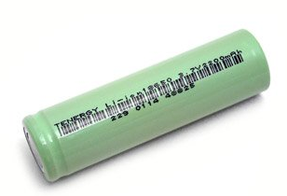
Thermal Dynamics of 18650 Li-ion Batteries in Runaway
J. G. Quintiere¹ and S. B. Crowley²
¹ University of Maryland, College Park, MD
² FAA Tech Ctr., Atlantic City, NJ

Slide 2

Objective
Measure energy produced during “Runaway”
Runaway: Rapid exothermic release of chemical energy
  Battery chemistry out of control
  Rate of reaction increases with temperature
  Energy release exceeds heat loss
Results
  High temperature
  Combustion
  Hot debris
Typical battery runaway event

Slide 3
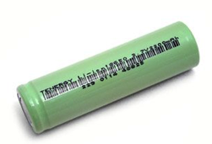
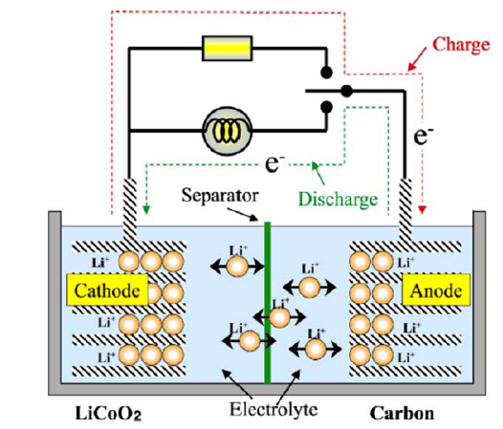
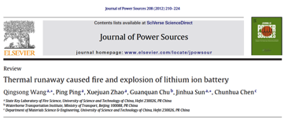
Typical li ion battery
18650: 18 mm diameter, 65 mm length
~ 44 g
Anode
  Graphite, Copper
Cathode
  Li oxide, aluminum
Separator
  PE or PP membrane
  Regulates ion flow
Electrolyte
  Organic combustible

Slide 4
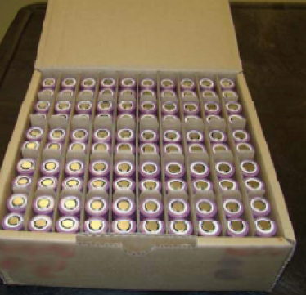
Causes of thermal runaway
Thermal All lead to temperature increase and acceleration of chemical decomposition
  Critical temperature triggers
  Due to heat source
  Separator melts, inoperative
Mechanical
  Physical damage
  Li dendrite grows to cause short
Electrical
  Overcharge
  Rapid discharge
Hazard: one bad apple!

Slide 5
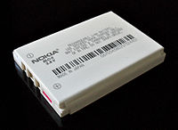
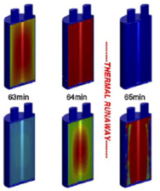
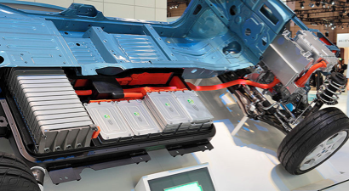
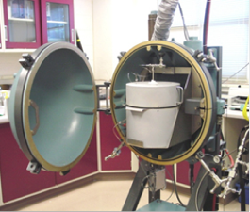
Background from literature
0ver 30 years of R & D on Li-ion batteries
Increasing applications
Modeling of Runaway
  Sophisticated
  Up to 6 decomposition reactions
  CFD thermo-chem-electrical analyses
Experimental
  Component studies
  DSC, ARC devices
Phone
Car

Slide 6
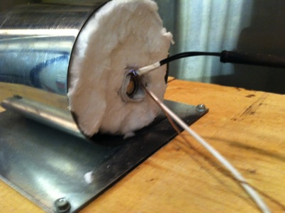
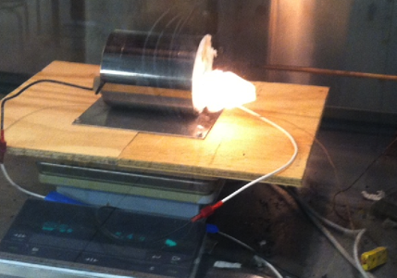
Measure runaway energy of 18650 li+
Build calorimeter with known heat input
18650 characteristics
  2.6 Ah @ 3.7 V or 34.6 kJ of electric power available
  Separator softens at 130ºC and melts > 150ºC
  PRV @ ~ 200 psi: white vapor emitted
  ~ 250 ºC onset of runaway, jump to ~ 800ºC in seconds
  Gases emitted: CO₂, CO, H₂, CH₄, other HC
  Solids emitted: Cu, Graphite, molten aluminum
Chemical – Electrical mechanisms not discerned

Slide 7
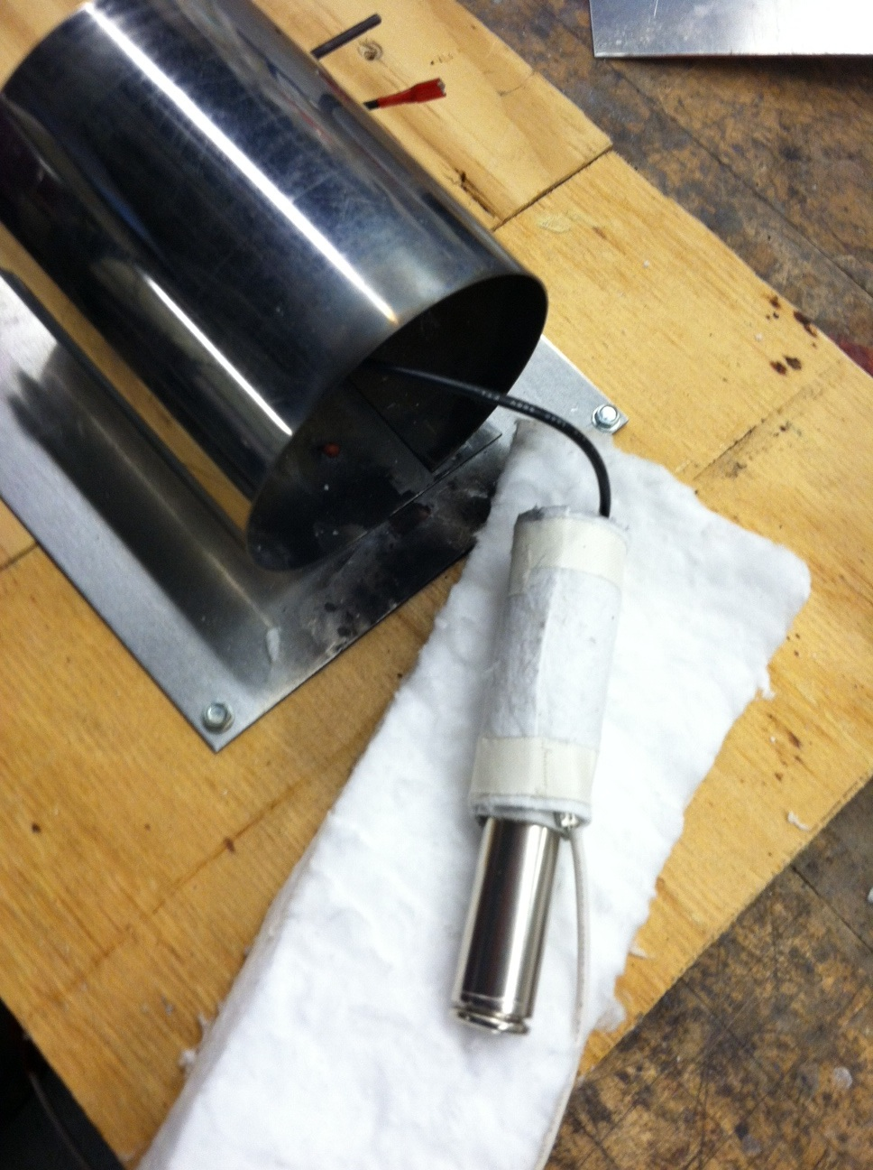
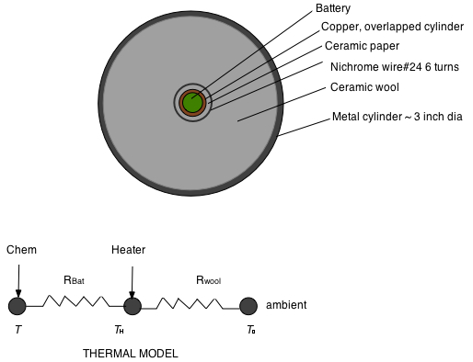
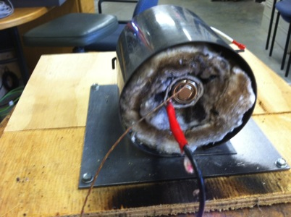
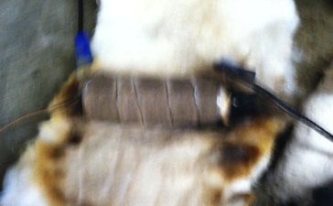
Apparatus design
Measure temperature and mass
& Heater: I x V = Watts

Slide 8
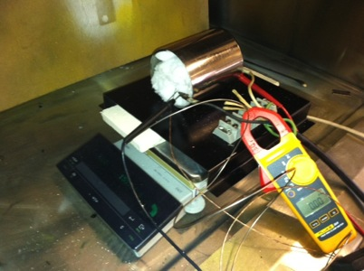
Measurements and analysis
Measure T on outer steel of battery
Measure m, mass of battery on load cell
Measure P, fixed power in by A x V = W
Calibrate heat loss through insulation & wires
  To match heat capacity of aluminum solid cylinder
Perform conservation of mass and energy for battery
Determine specific heat of battery
Determine energy transfer during heating and runaway
  As a function of State of Charge (SOC)
  As a function of Power In (P)

Slide 9
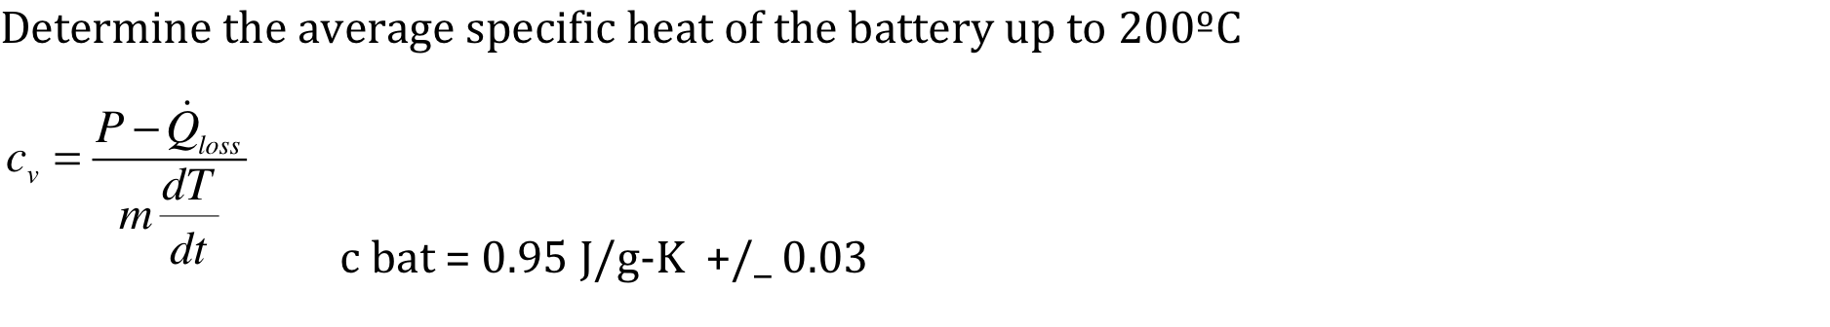
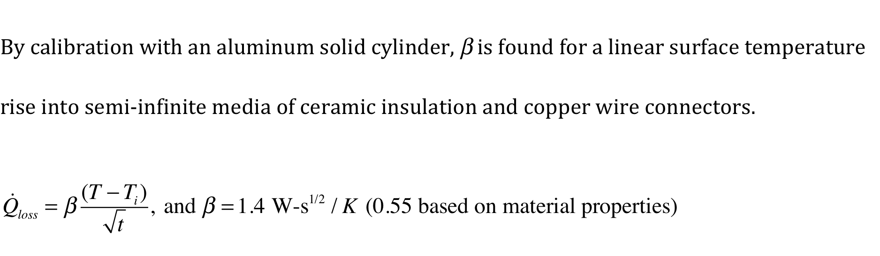
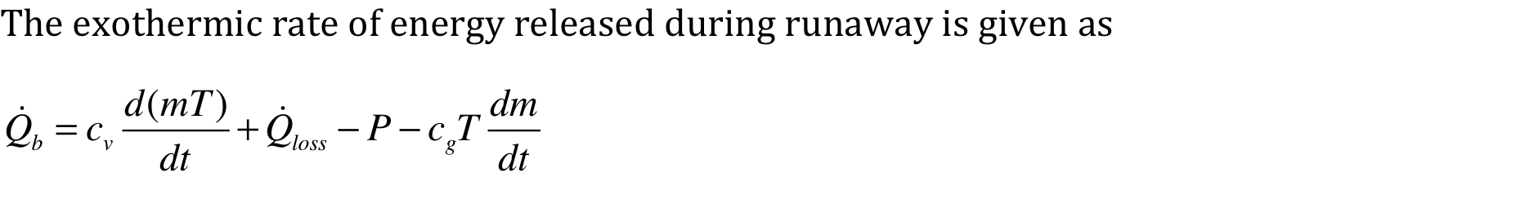
Analysis
Sensible energy of battery
and copper sleeve
Convective energy
out of battery

Slide 10
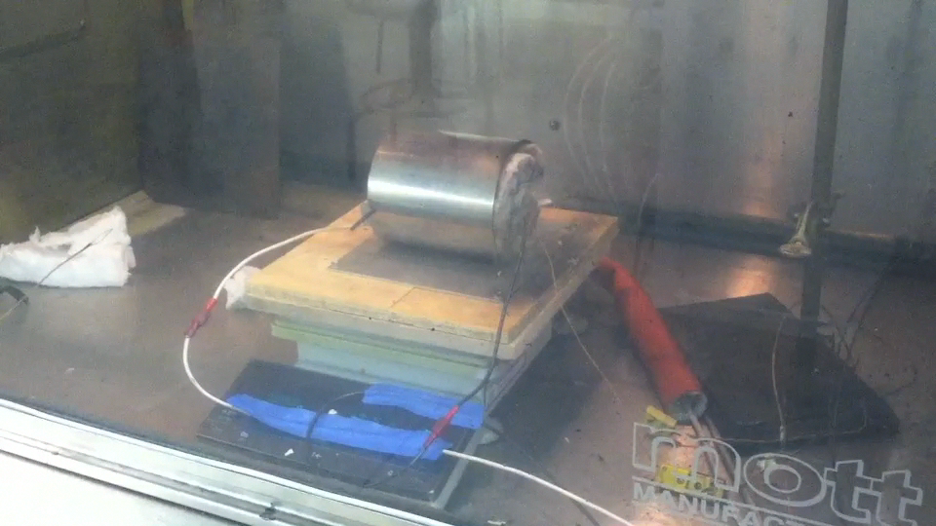
Typical test:
SOC 90 % 25 W: edited after first vent
White smoke: then runaway, ejected contents

Slide 11
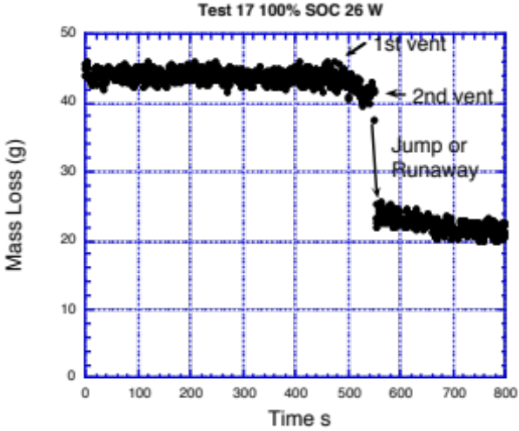
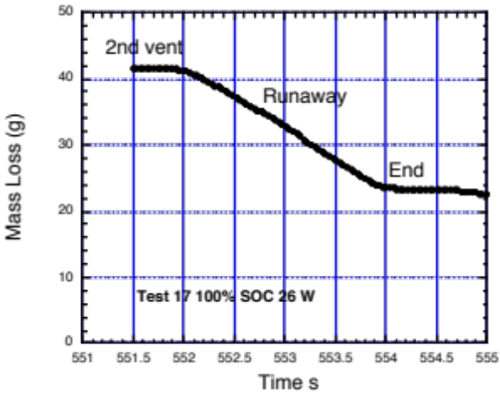
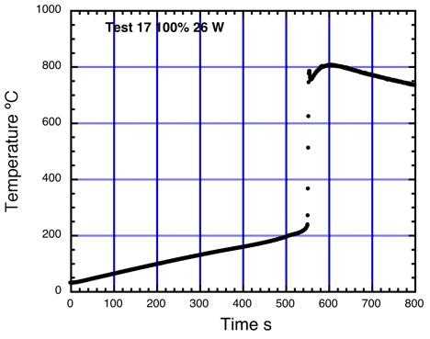
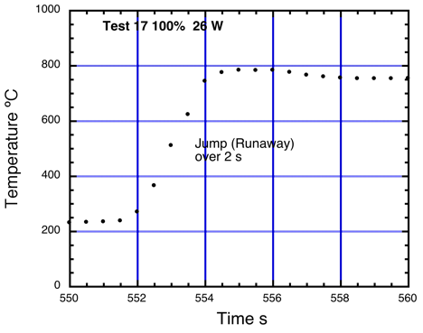
Typical data: Test 17 100 % 26 W
1st vent @ 470 s
Lose ~ 2 - 3 g
~ 200 ºC
2nd vent @ 552 s
Runaway ~ 2 s
Lose ~ 17 g
T: ~ 250 ºC to ~ 800 ºC
Final: ~ 22 g out of 44 g lost

Slide 12
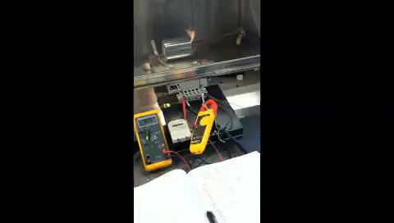
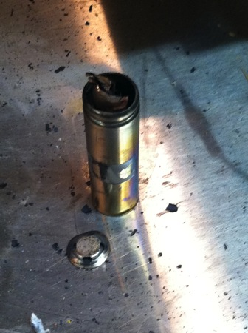

Catastrophic examples:
Expelled debris or Rocketed battery
Graphite & copper expelled
Damaged instrument wires
Blown cap
Rocket

Slide 13
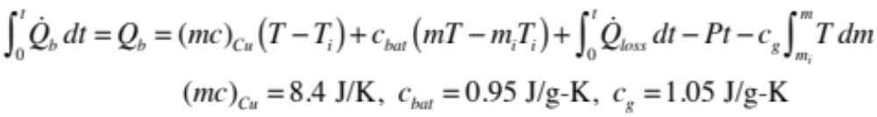
Reduced data
Cannot accurately evaluate derivatives of T and m
Therefore use integral of energy rate equation:
Q_{b} is exothermic energy from runaway
m,c,T terms are internal energy of copper sleeve and of battery
c_{g} is specific heat of expelled matter (1 – 2 J/g-K ?, used 1.05)

Slide 14
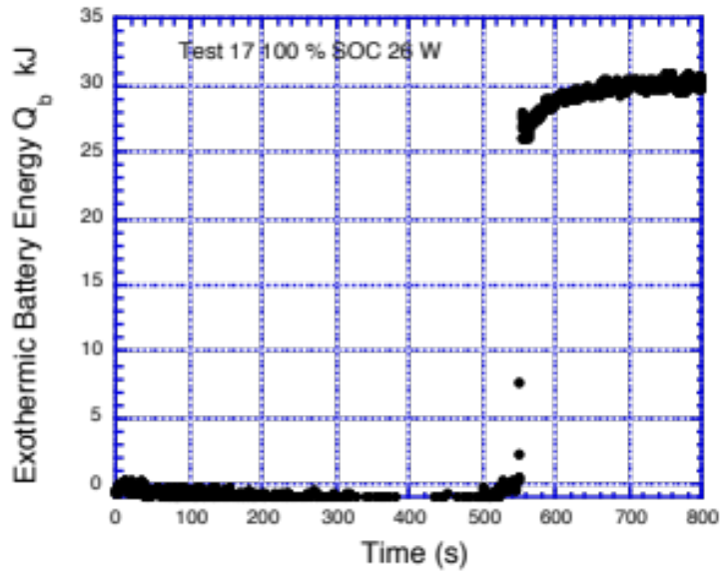
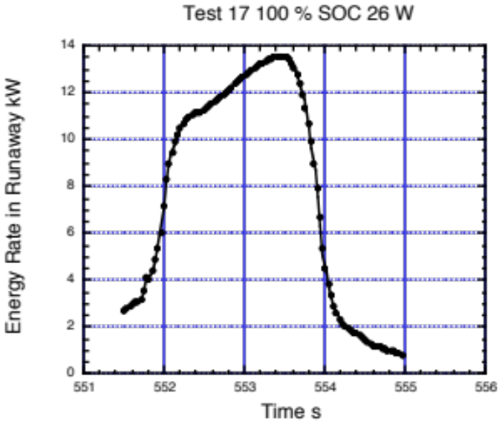
Typical results of analysis:
Test 17 100 % 26 W
Exothermic energy ~ 30 kJ
Original Chemical-Electrical energy 34.6 kJ

Slide 15
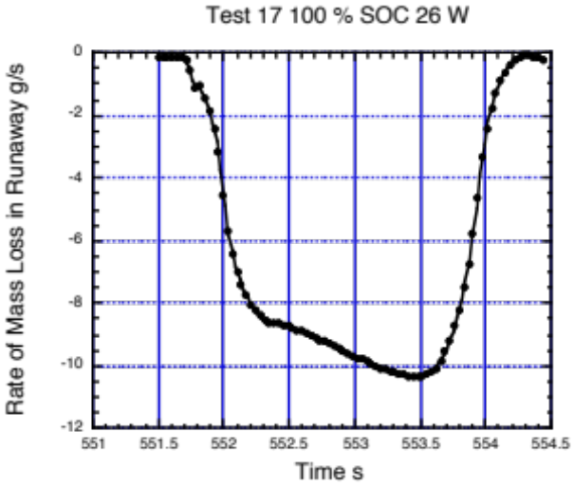
Typical results of analysis:
Test 17 100 % 26 W
How about mass expelled from battery consumed by combustion?
From Cone calorimeter data of similar battery @ 100%
~ 3 – 5 kJ/g lost
Therefore ~ 4 kJ/g x 10 g/s = 40 kW peak
Or overall ~ 4 kJ/g x 22 g lost = 88 kJ by combustion

Slide 16
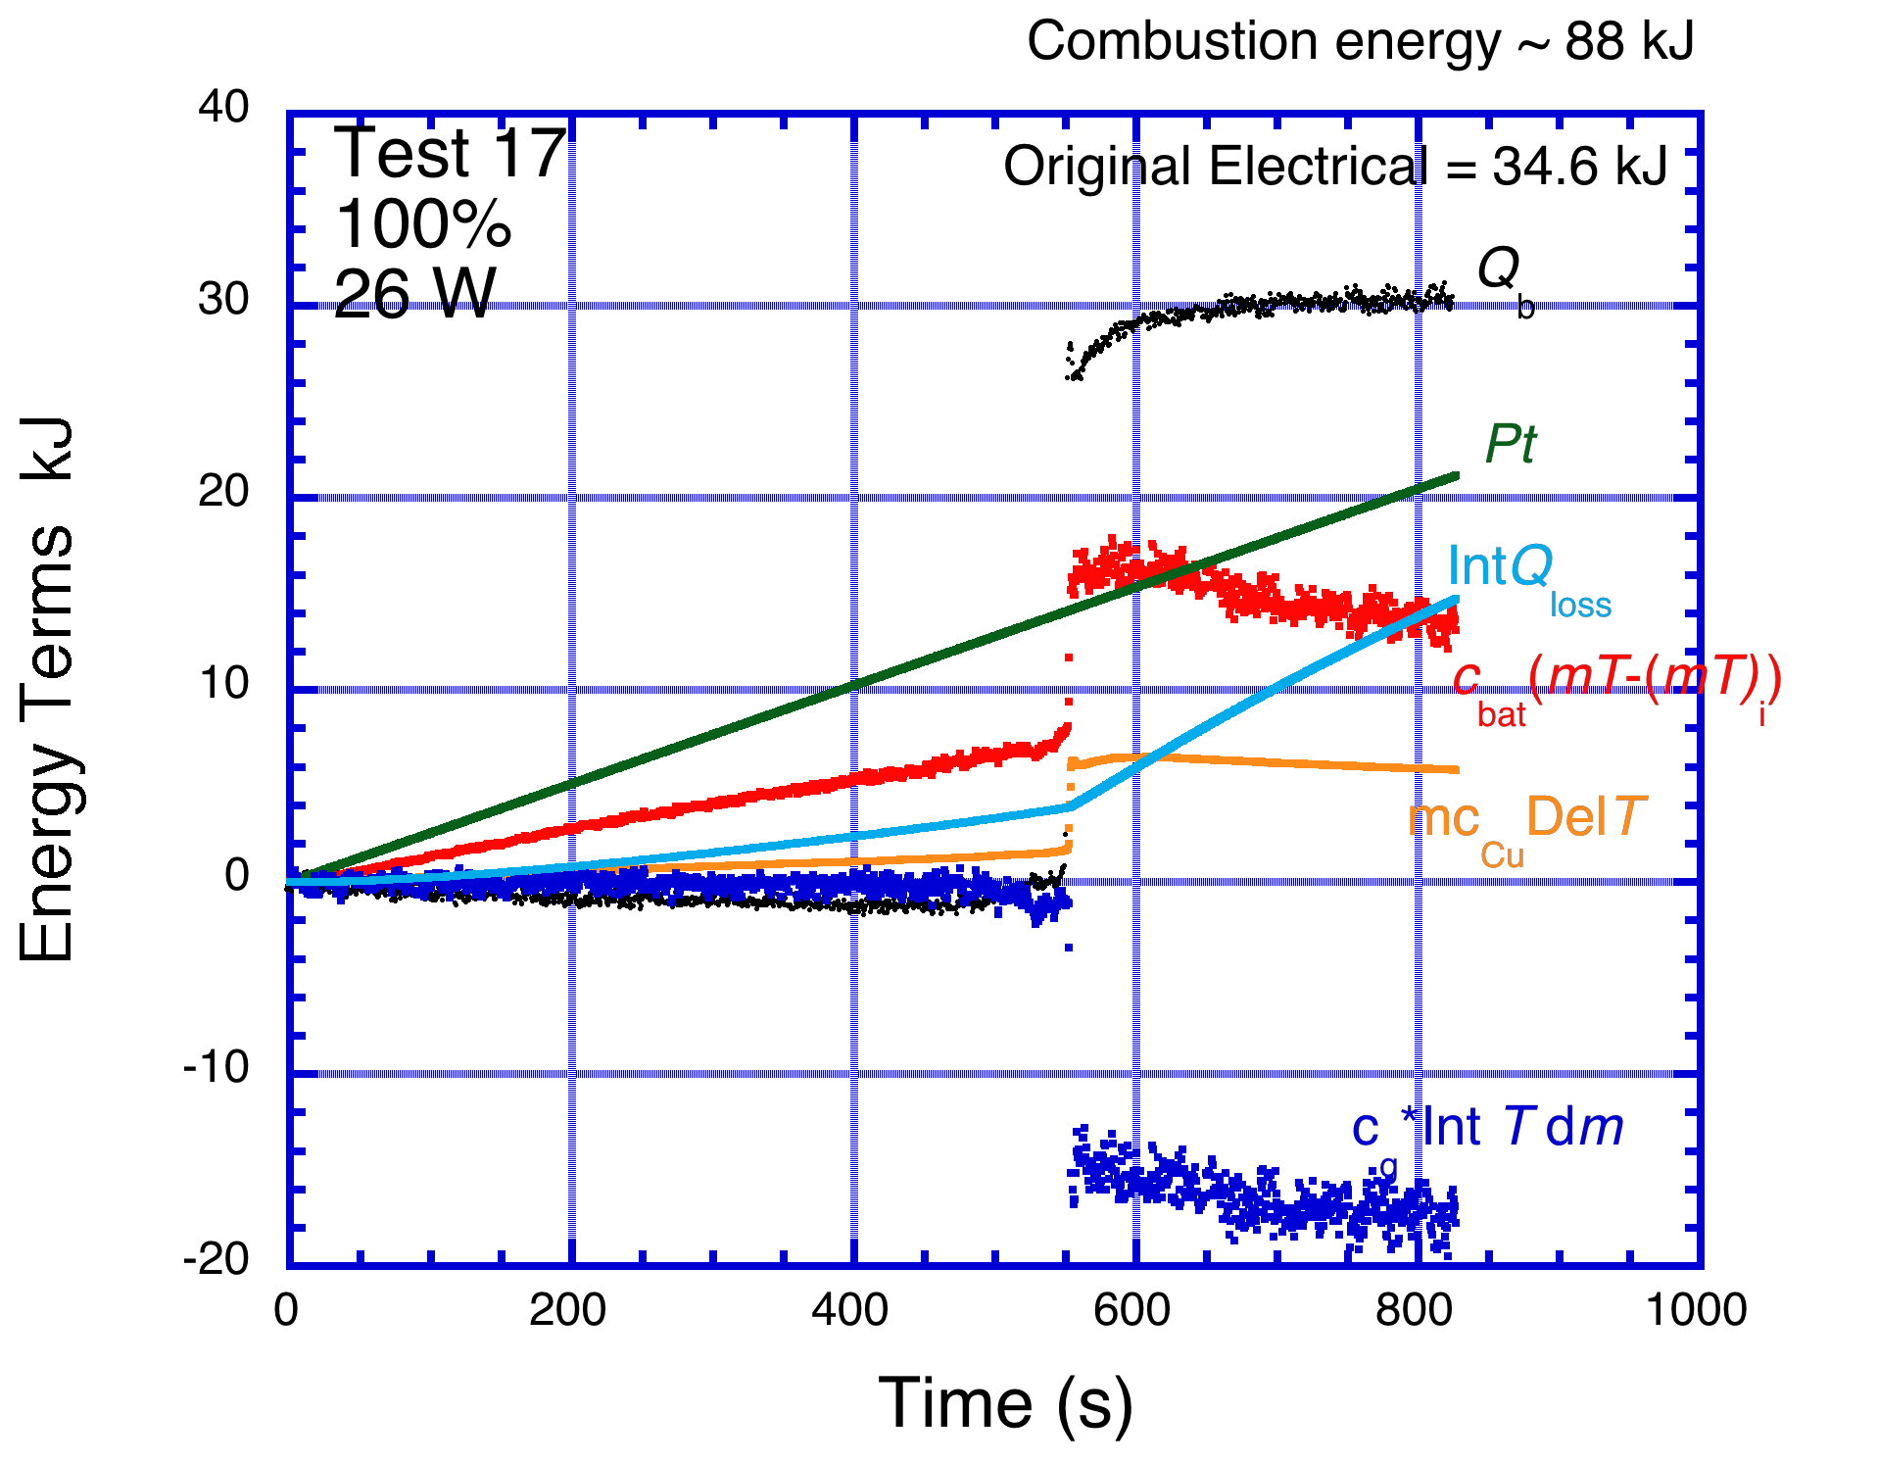
Typical: Test 17 100 % 26 W
Exothermic energy
Contributes to:
1. Temperature increase in battery
2. Hot mass expelled
3. External combustion

Slide 17
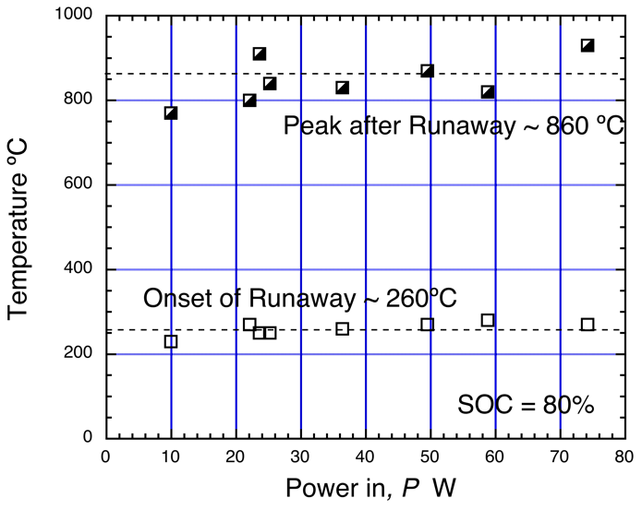
Overall results: At 80% SOC varying P key Temperatures……….insensitive to P

Slide 18
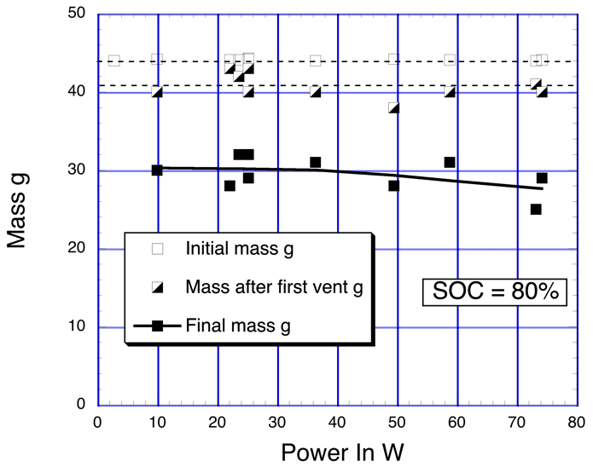
Overall results: At 80% SOC varying P key mass loss…….insensitive to P
Original = 44 g
After 1st vent ~ 41 g
Final mass ~ 28 – 30 g

Slide 19
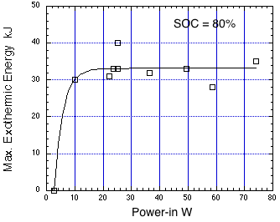
Overall results: At 80% SOC varying P
Exothermic energy…….insensitive to P after 9 W
Threshold power 3 – 9 W
Max ~ 33 +/- 4 kJ
Original Electric ~ 35 kJ

Slide 20
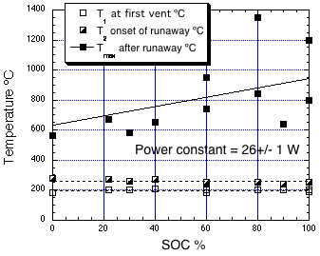
Overall results: At ~ 26 W, varying SOC key Temperatures……….insensitive to soc for T₁ T ₂
1st vent ~ 200 ºC
2nd vent ~ 260 ºC
Peak after runaway 600 to 1000ºC
0% SOC questionable

Slide 21
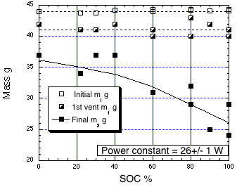
Overall results: At ~ 26 W, varying SOC key mass loss…….insensitive to soc after 1st vent
Original = 44 g
After 1st vent ~ 41 g
Final mass decreases with SOC
from 36 to 26 g

Slide 22
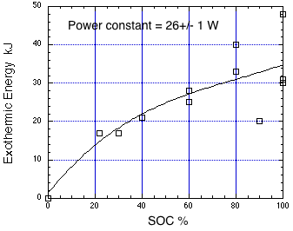
Overall results: At ~ 26 W, varying SOC
Exothermic energy…….increases with SOC
Original Electric ~ 35 kJ
0% SOC is questionable
Energy actually endothermic
after long time ~ 3000 s

Slide 23
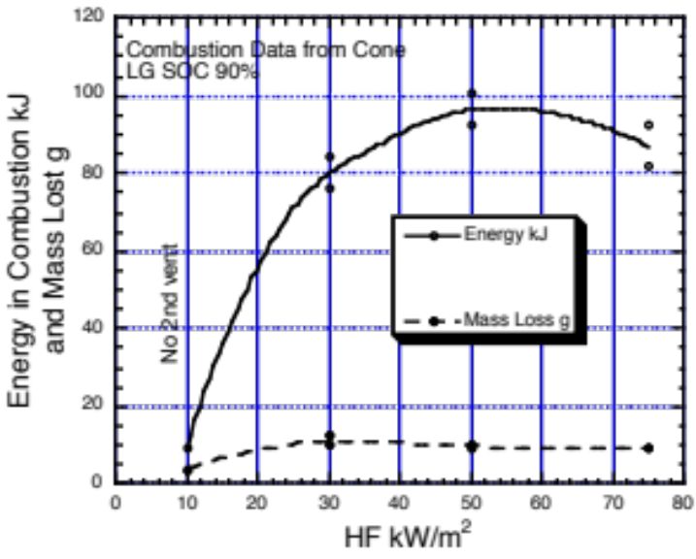
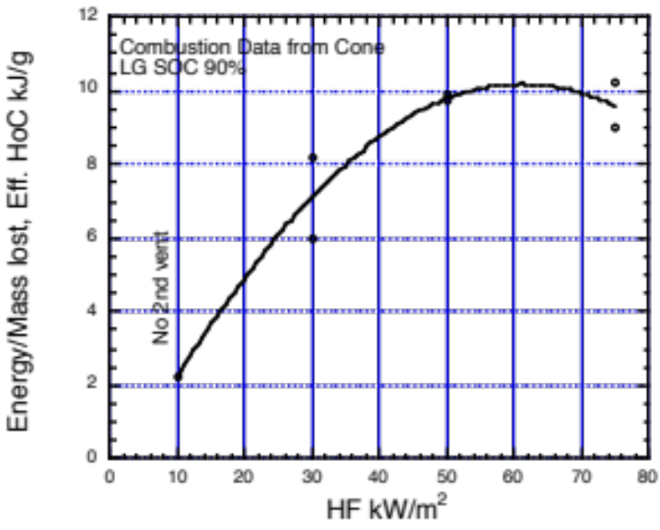
Combustion Results from Cone calorimeter
Exothermic energy & mass varying Heat flux @90% soc

Slide 24
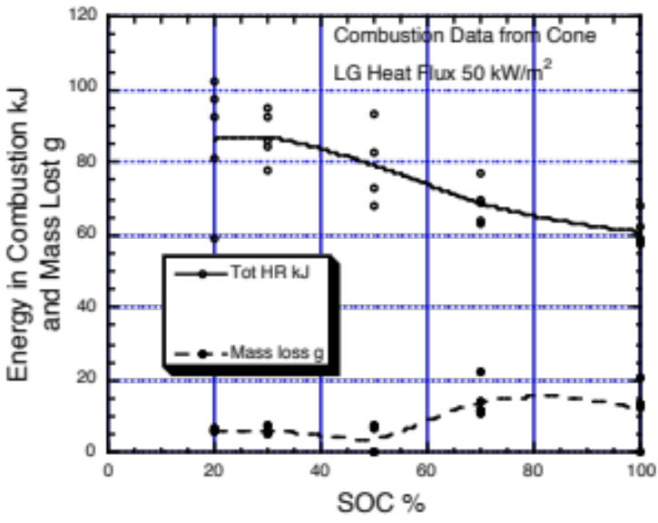
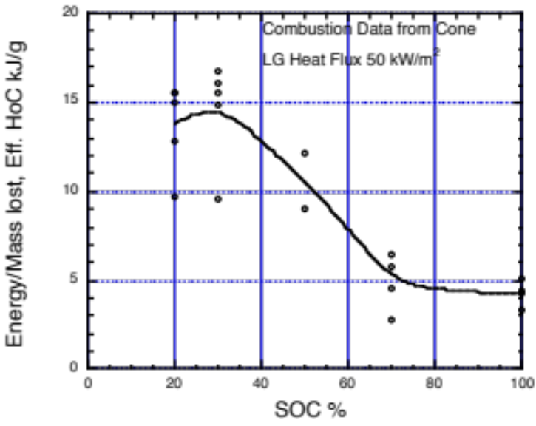
Combustion Results from Cone calorimeter
Exothermic energy & mass varying soc @ 50 kW/m²

Slide 25
Findings
For 18650 Li ion battery with 34.6 kJ electric power and 44 g
Runaway results most dependent on SOC
  Tests at 0% and at 0.5 V display limited or no runaway
  Mass loss increases from about 8 to 19 g with increasing SOC
  Exothermic runaway energy increases from about 20 to 40 kJ with SOC
  Combustion energy decreases from about 90 to 60 kJ with SOC (Cone data)
  Temperatures of battery and exit debris increase from about 600 to 1000ºC with SOC
  Duration of runaway ~ 2 s
  Duration of flaming ~ 10 s
  Duration of hot battery ~ 100+ s

Slide 26
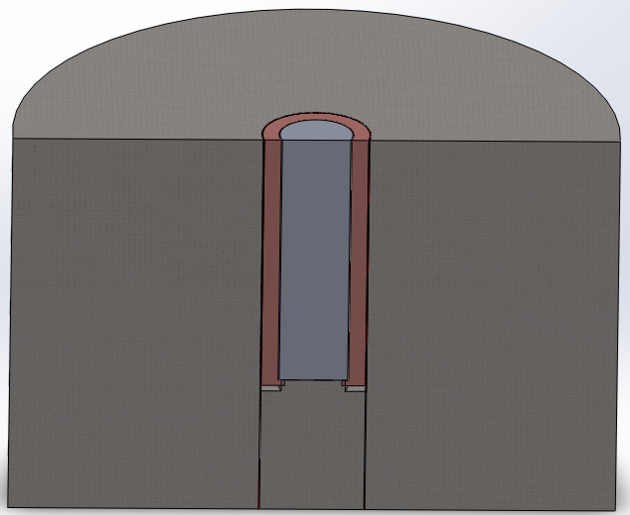
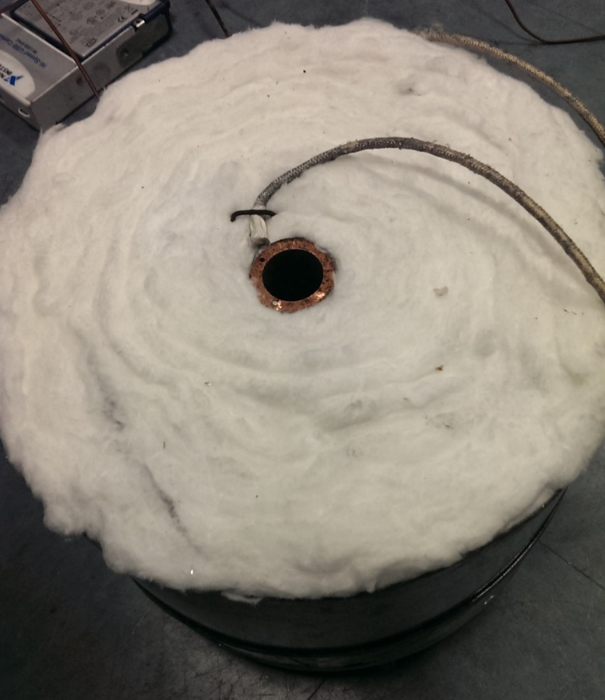
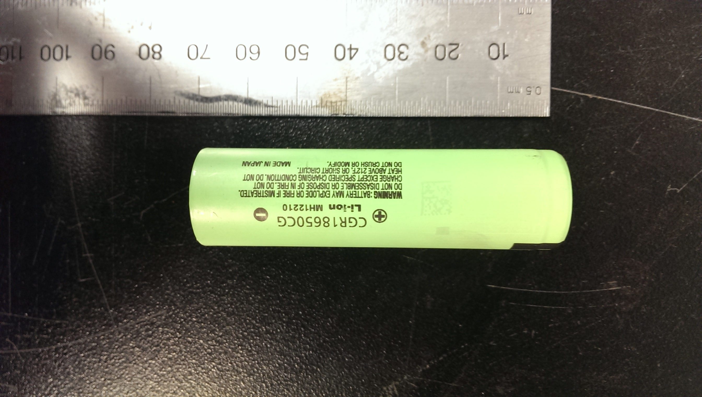
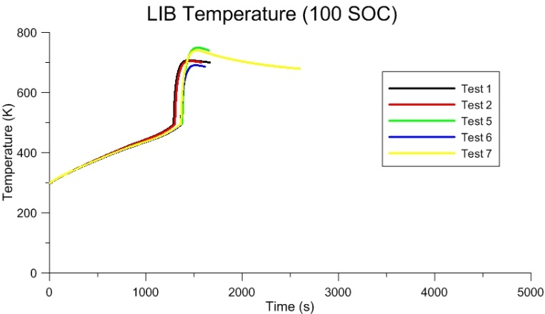
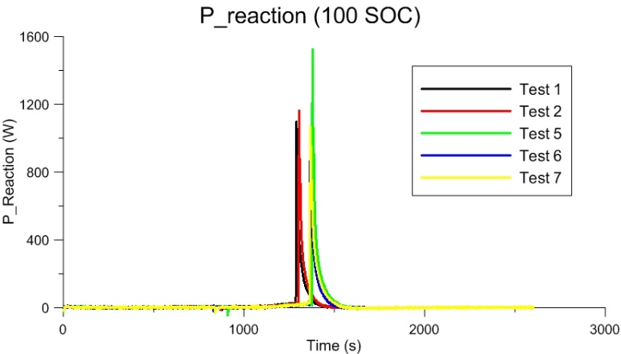
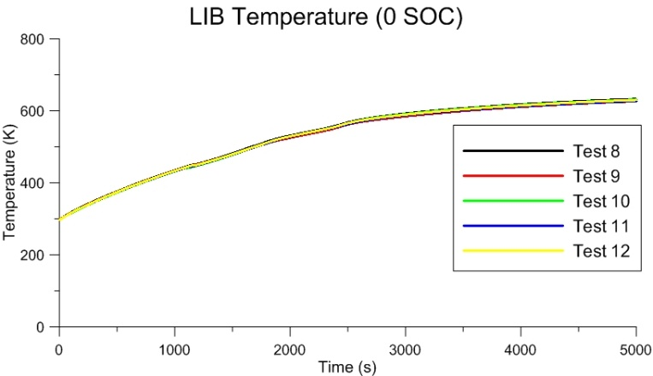
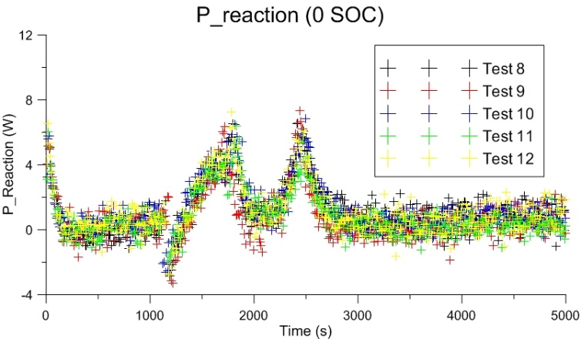
University of Maryland work – Fire behavior of Lithium ion batteries
Xuan Liu (Ph.D student), Prof. Stanislav I. Stoliarov
Copper Battery Container
Copper Battery Container
Thermocouple
Testing Sample: Panasonic 18650 Li-ion Battery
20W DC
Heating element
20W DC
Insulation Material
Insulation Material
18650 Battery
Power loss calibration
Specific heat of Li-ion battery
Mass loss change
AVG Integrated Energy: 31.2 kJ
Evolution of energy released by chemical reactions inside battery is determined
AVG Integrated Energy: 4.9 kJ
Supported by Ford Motor and FAA

Slide 27

Hazard analysis & future work
Use experimental results in thermal model
Investigate batteries in array
  Model packaging material
  Develop rate of spread
Model exothermic runaway from Thermochemistry
  Electrical energy converted to heat
  Arrhenius reaction
Model mitigation strategies

Slide 28
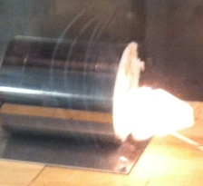




That’s all for Batteries
Please come back and visit the Mummers Parade
New Year’s Day 2014
Philadelphia, PA

