Slide 1
The Investigation of a Lithium-Ion Battery Fire Onboard a Boeing 787
- Aspects of the Laboratory Analysis
Joseph Kolly, PhD. Director, Research & Engineering Joseph Panagiotou
Barbara Czech
The Seventh Triennial International Fire & Cabin Safety Research Conference
December 2-5, 2013

Slide 2
Overview of Presentation
Background of Incident
Battery Design
Investigative Methods
Summary

Slide 3
Participants
Parties
  FAA
  Japan Airlines
  Boeing Commercial Airplanes
  Thales Avionics Electrical Systems
  GS Yuasa
  JTSB*
  BEA*
Consultants
  NSWC Carderock
  US DOE
  TIAX

Slide 4

JAL Boeing 787
Logan International Airport –Jan 7, 2013

Slide 5
Timeline
10:06am - aircraft arrived at gate in Boston from Narita, Japan
  183 passengers and 11 crew deplaned
10:32am - Cleaning and maintenance crew noticed smoke in cabin
10:35am - Mechanic noted flames coming from APU battery in aft electronics bay

Slide 6
Timeline, cont.
10:37am – Airport Rescue & Fire Fighting notified
10:40am – Fire and rescue personnel arrive on scene
12:19pm – Fire and rescue personnel report event was “controlled”

Slide 7
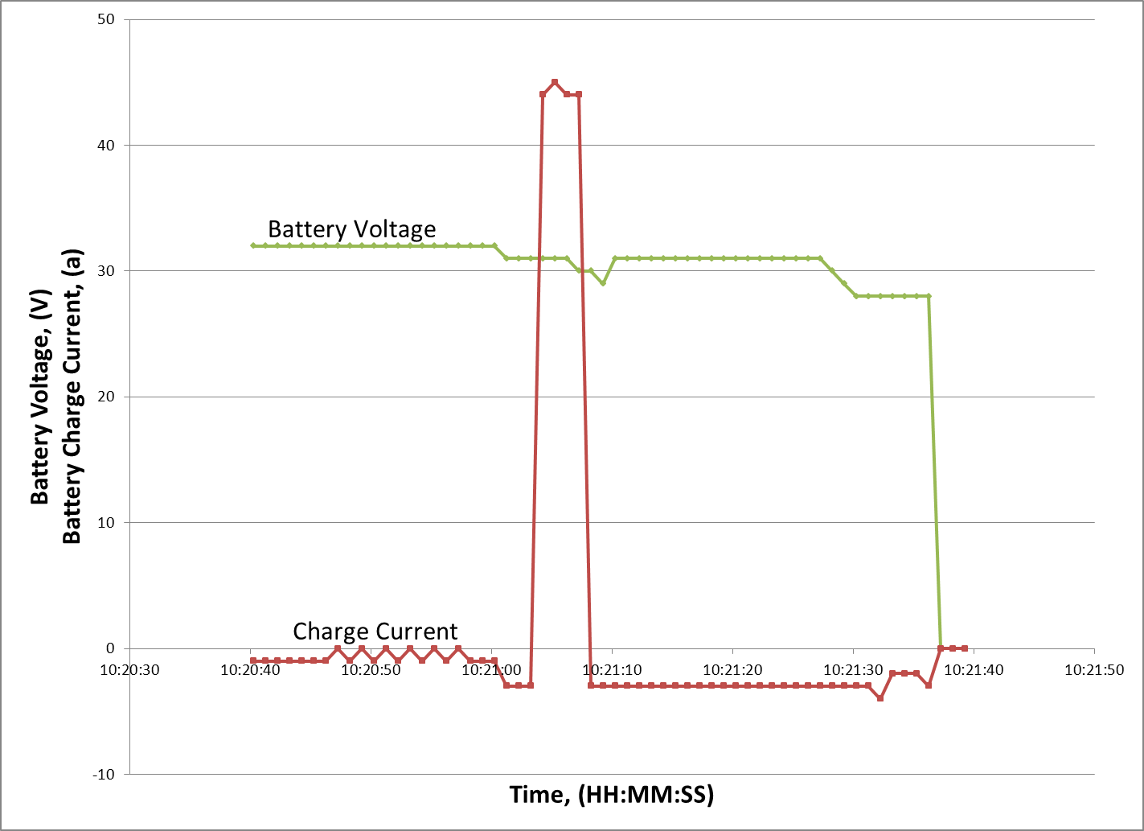
Battery Failure as Captured on FDR

Slide 8

Li-Ion Battery Locations in B-787
(same model battery used in each location)
Main battery
location
Auxiliary Power Unit (APU)
battery location
Lithium Cobalt Oxide
3.7 Volts per cell (nom)
~ 32 Volts total

Slide 9
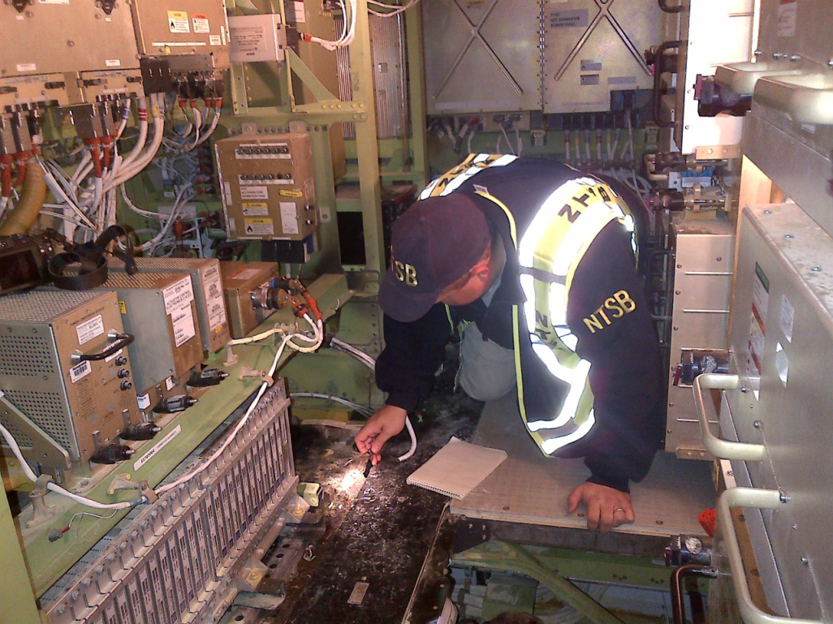
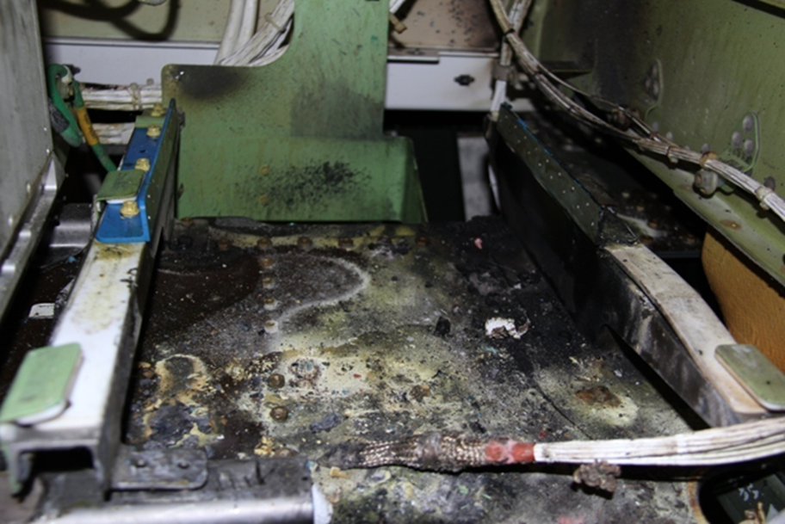
Damage to Aft Electronics Bay

Slide 10
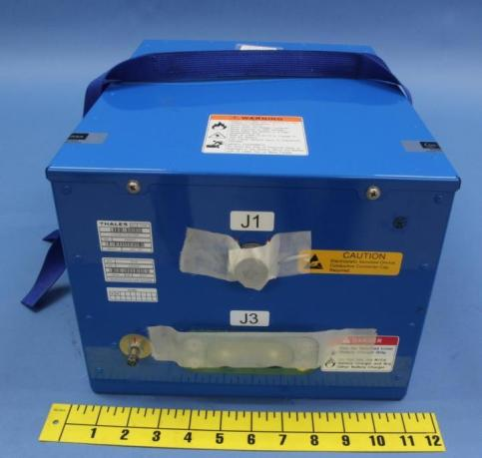
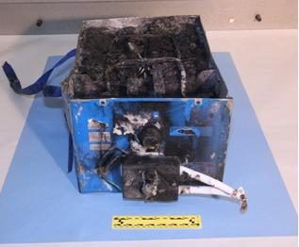
APU and Main Batteries
Exemplar (main) Battery
Incident (APU) Battery

Slide 11
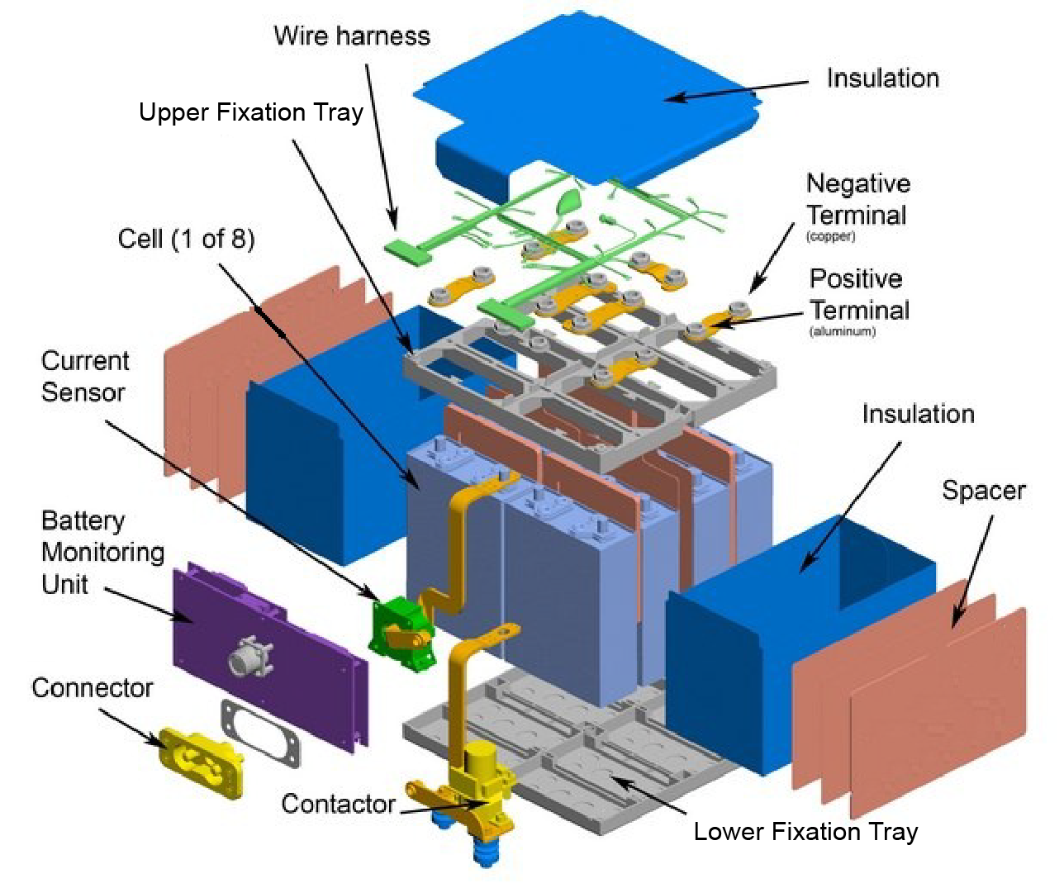
Component View of Battery

Slide 12
Battery Specifications
Li-Ion 8 cell battery
Lithium Cobalt Oxide/Carbon Electrode
Organic Solvent Electrolyte
 | Battery | Cell
Nominal capacity (ampere-hour) | 75 | 75
Nominal voltage (volts) | 29.6 | 3.7
Weight (pounds) | 61.8 | 6
Dimensions (inches)
Width | 10.9 | 5.2
Depth | 14.2 | 2.0
Height | 8.5 | 7.7

Slide 13
External Observations

Slide 14
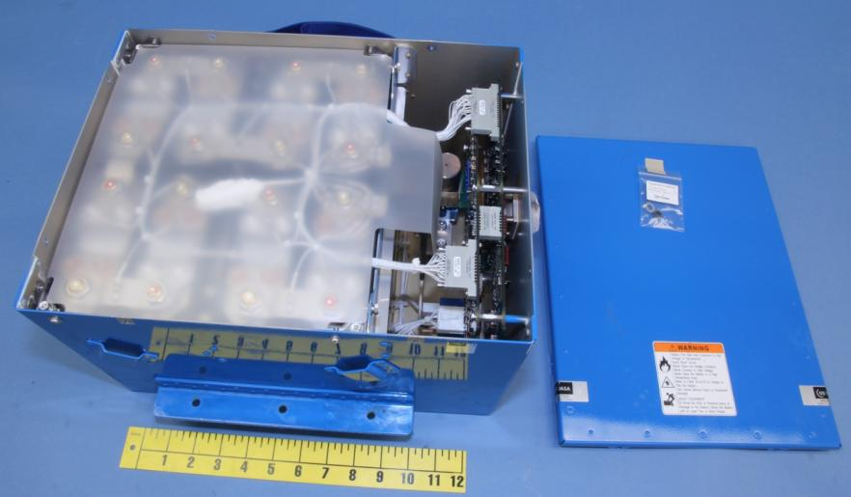
Undamaged Battery with Cover Removed
Top Insulator
Removed Lid
a

Slide 15
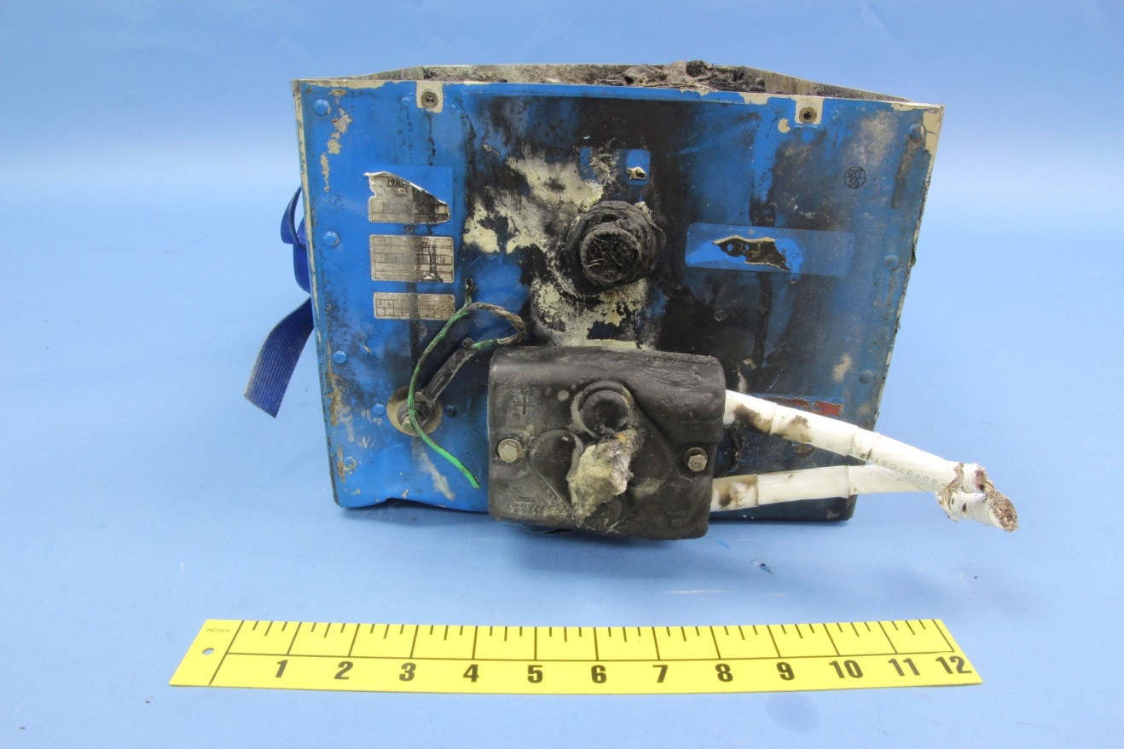
Front View with Top Cover Removed

Slide 16
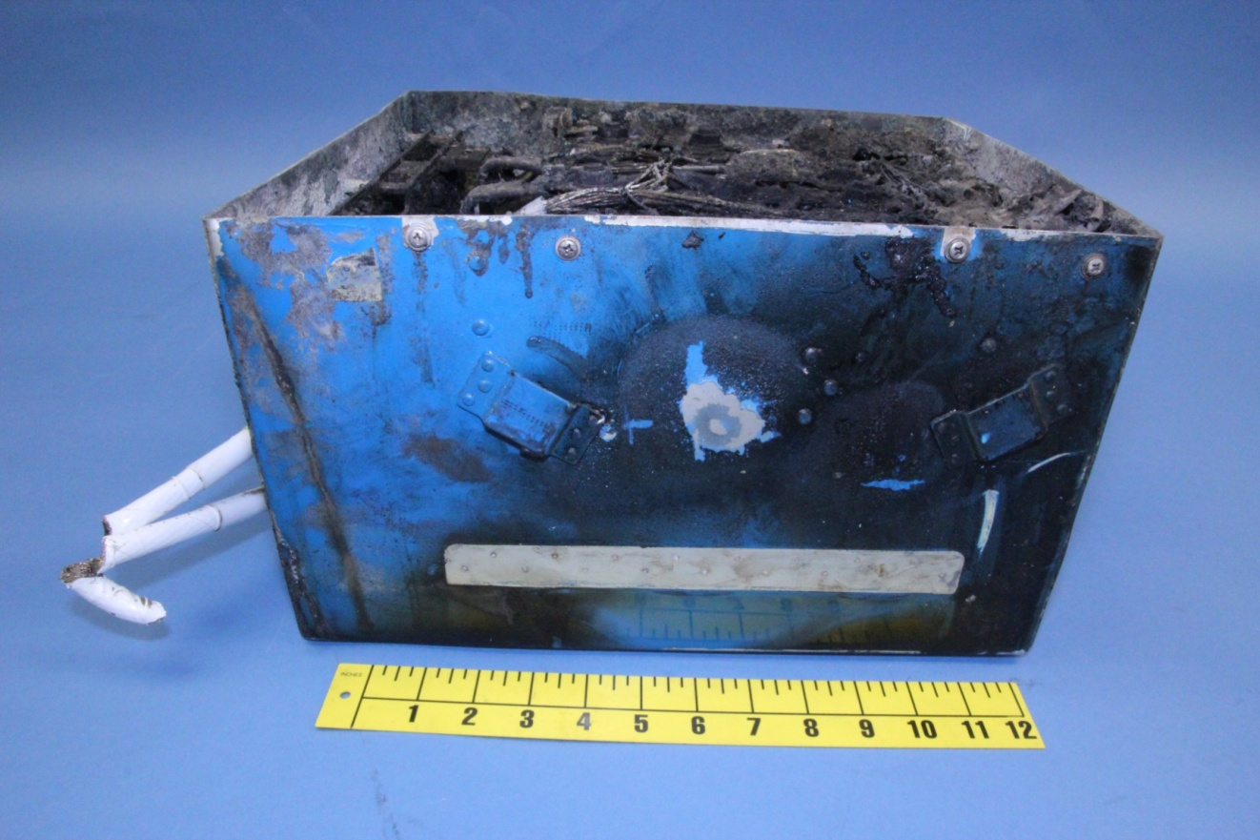
Side View with Top Cover Removed

Slide 17
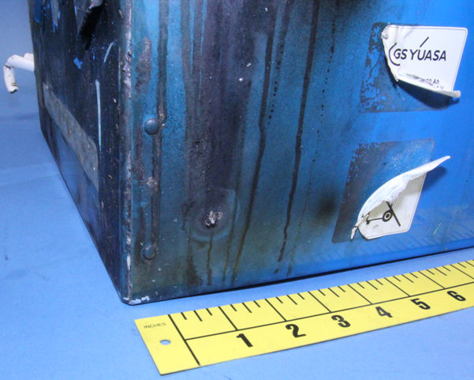
External “Protrusion”

Slide 18
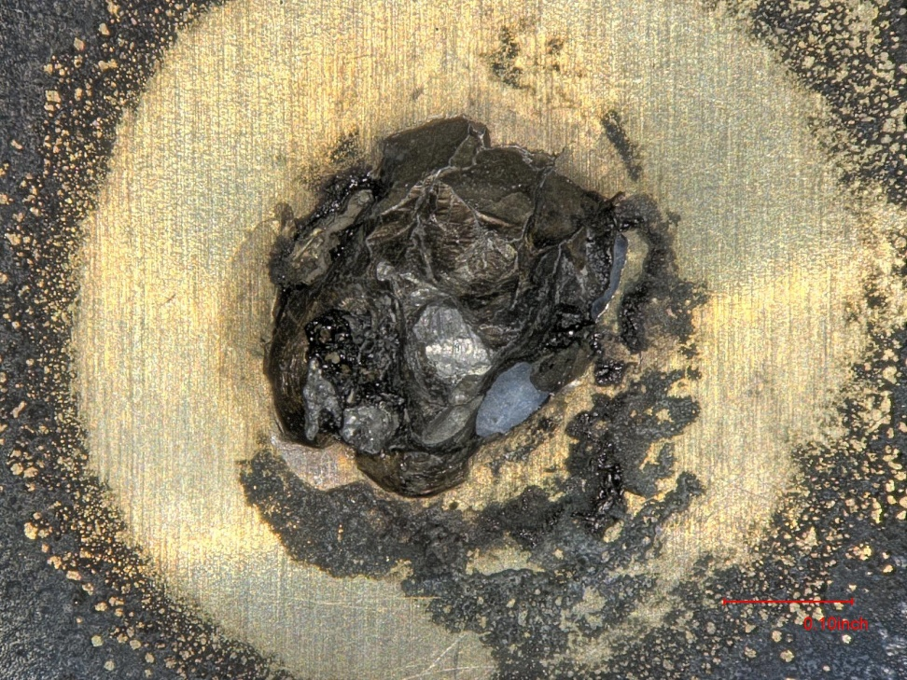
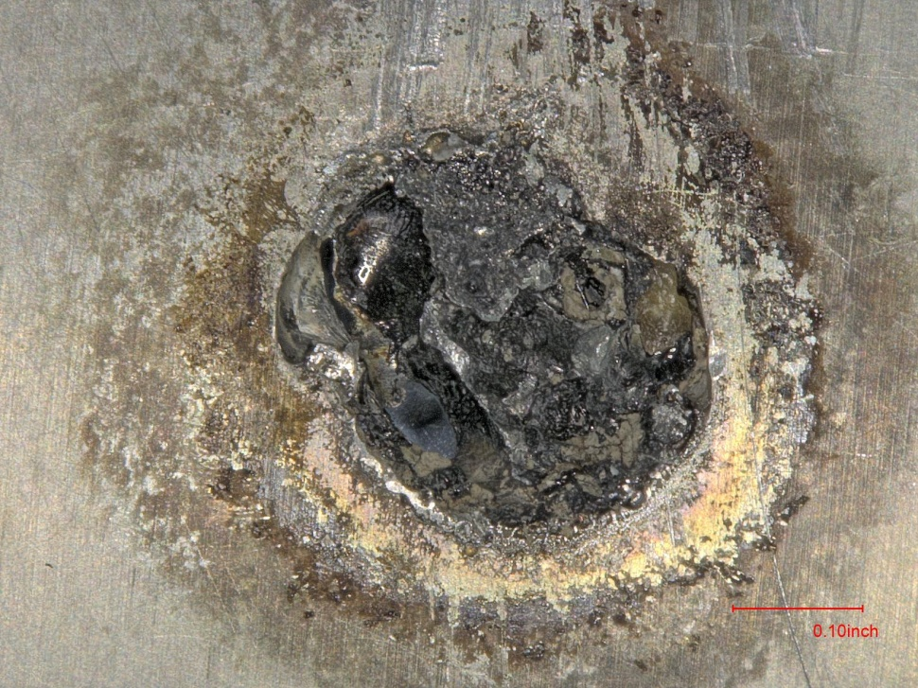
External “Protrusion”
Viewed From Outside (Post-clean)
Viewed From Inside (Post-clean)

Slide 19
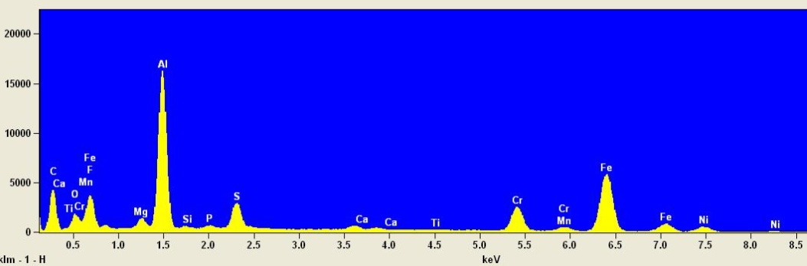
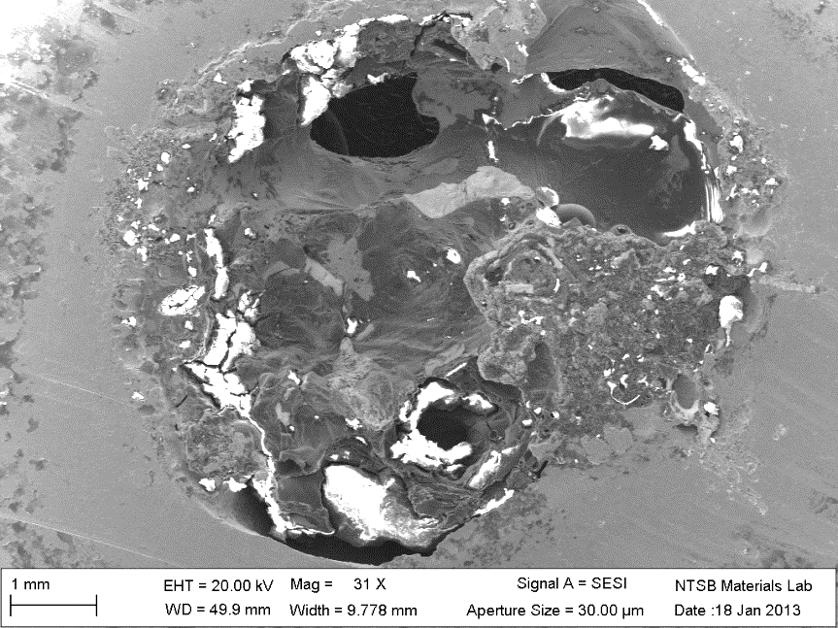
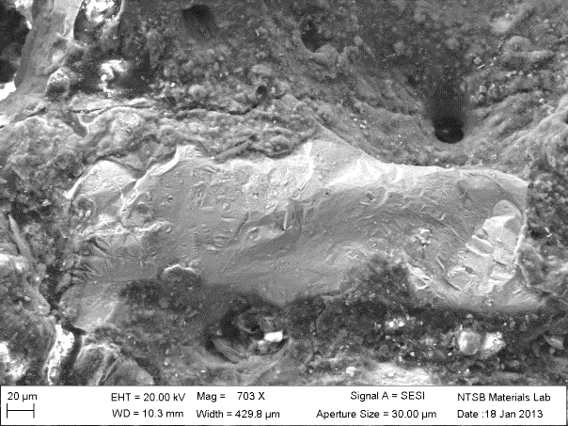
SEM/EDS Inspection and Analysis of Protrusion
CRES Elements

Slide 20
Internal Observations (Battery Level)

Slide 21
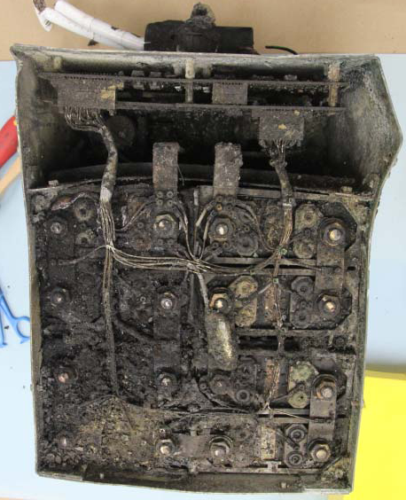
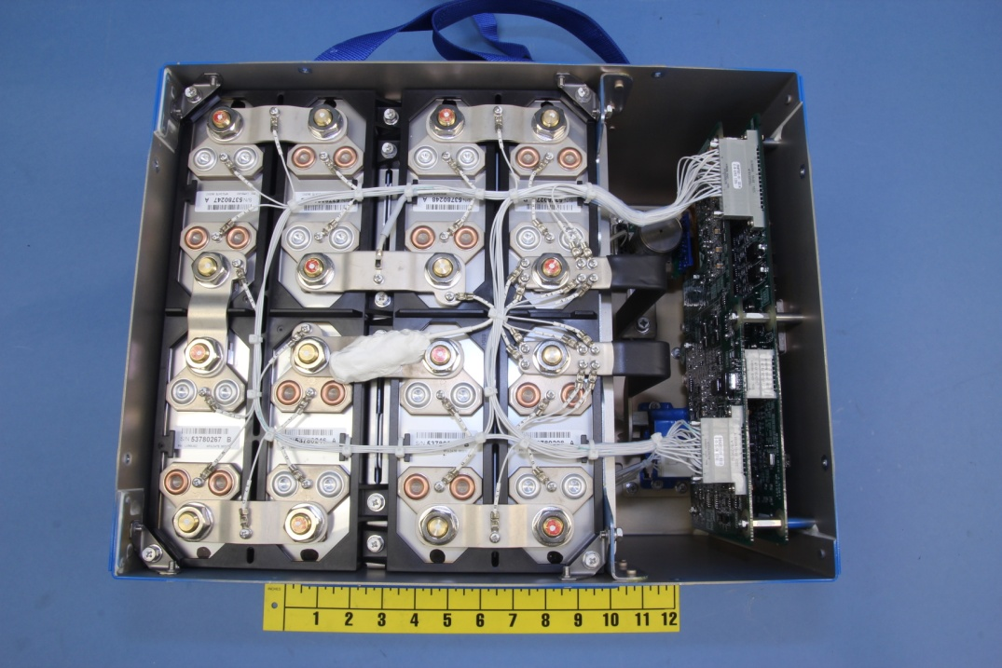
Top View of Battery (cover removed)
Main Battery
APU Battery

Slide 22
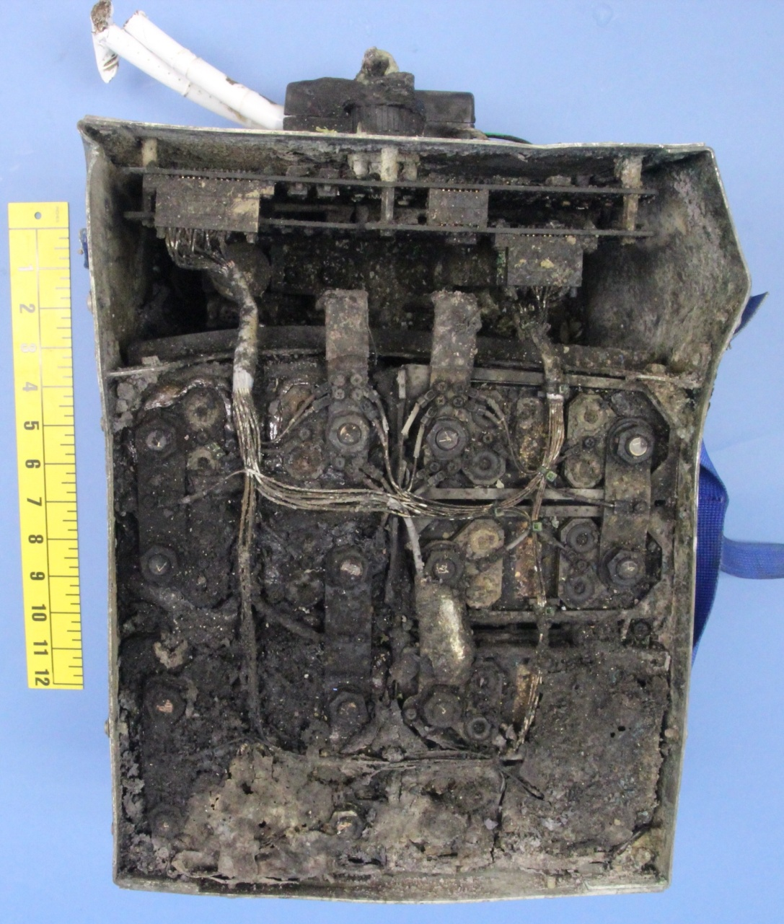
Thermal Damage
8
1
Area of most thermal damage
7
2
6
3
5
4

Slide 23
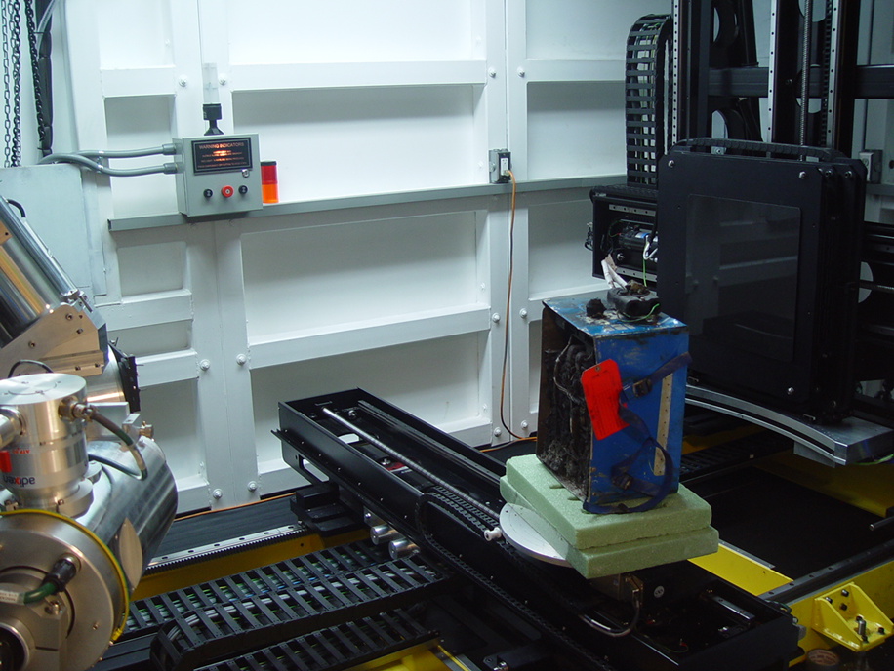
Radiography Specifications
Nikon Metrology
450 kV Microfocus scanner
X-ray focal spot size 80 microns
Scan volume 1600 x 1700 x 2000
File size 5.8 - 24 Gb
Post-processing with VGStudio Max

Slide 24
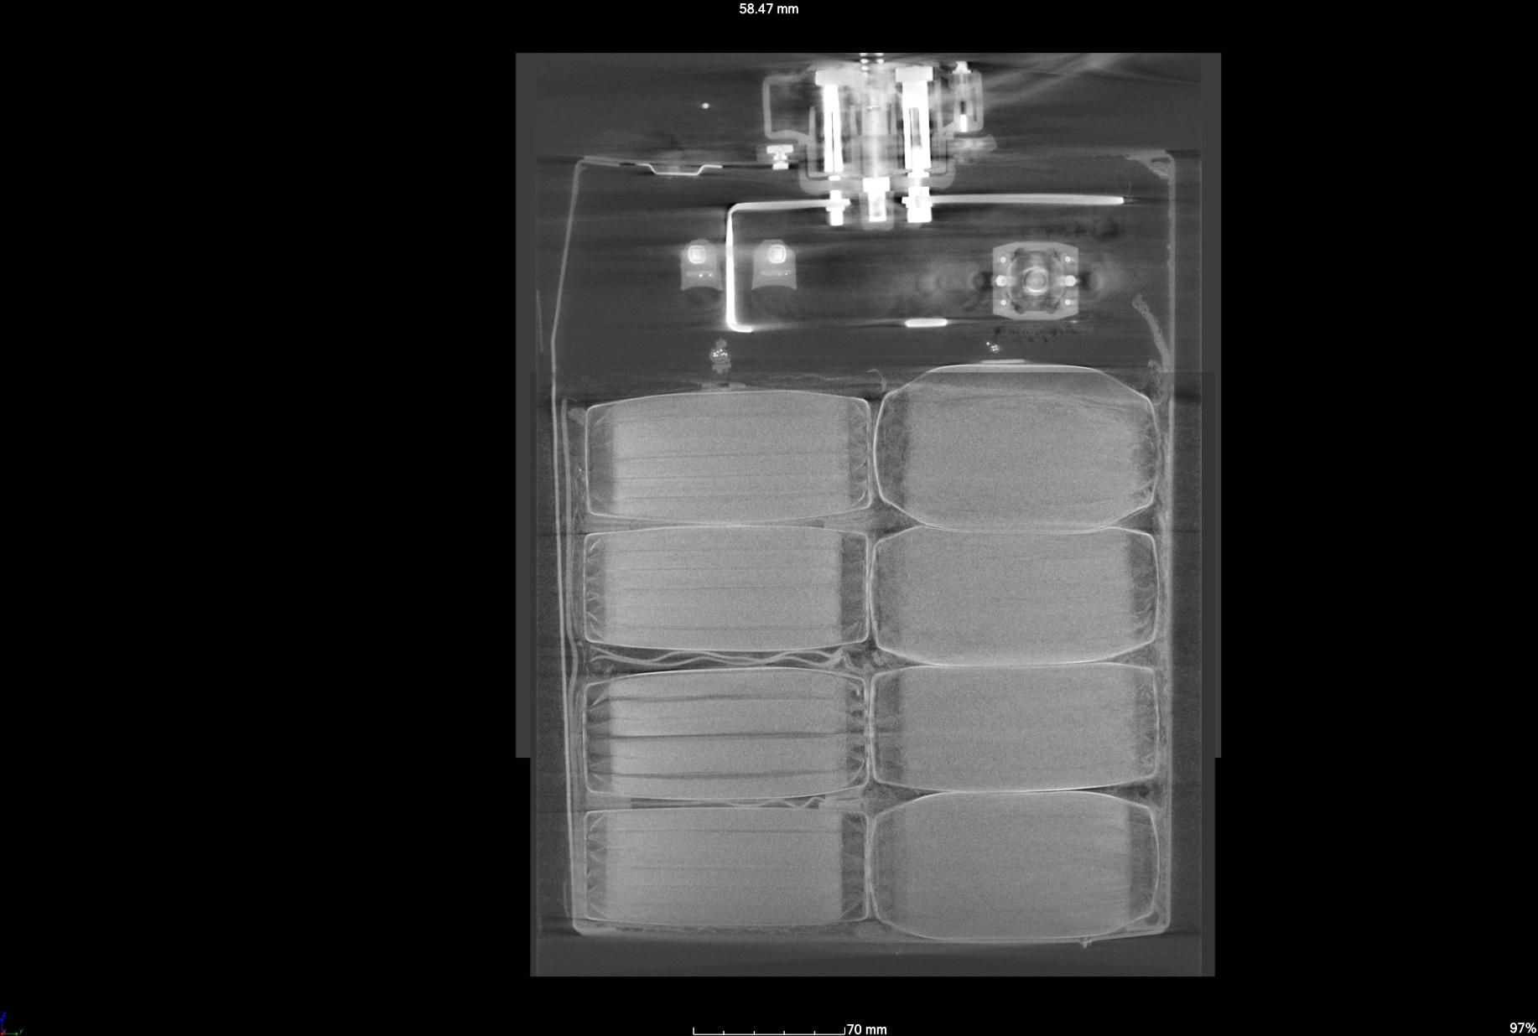
Mechanical Damage (Digital Radiograph)
8
1
7
2
6
3
5
4

Slide 25
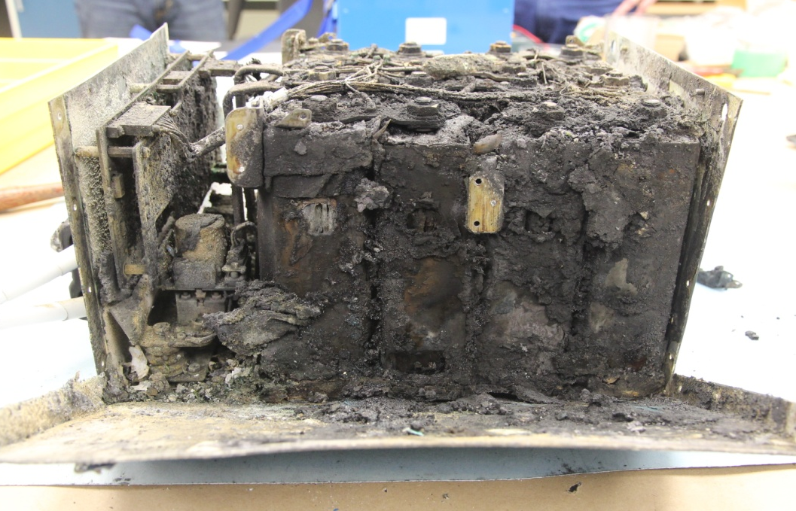
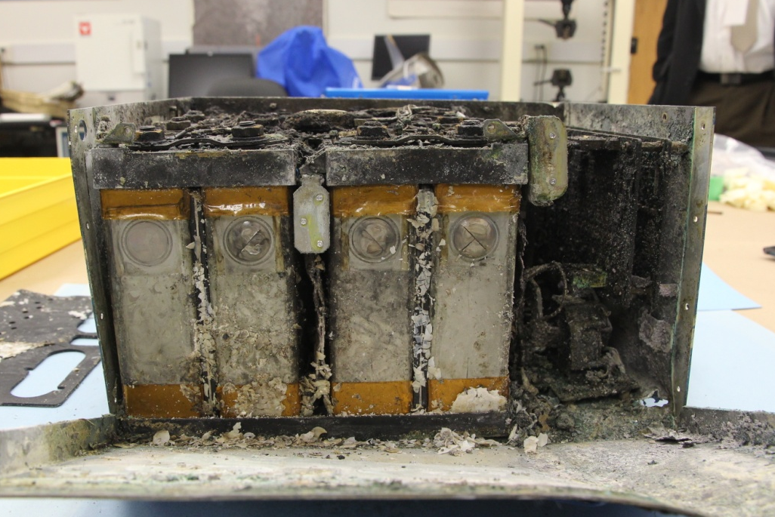
Inside the Battery
Cells on the left side
Cells on the right side
7
6
5
4
3
2
1
8
Substantial thermal damage
Moderate thermal damage

Slide 26
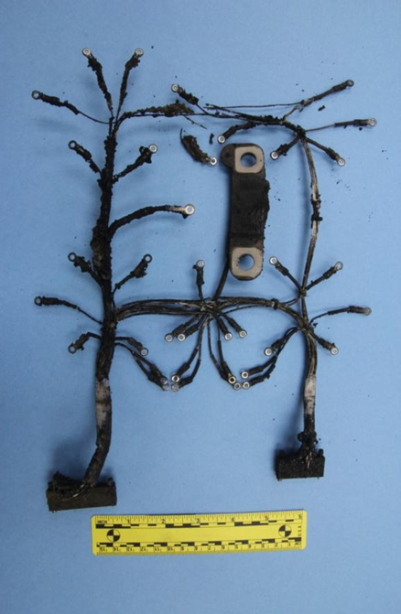
Wiring Harness of Battery
Visual examination
Radiographic examination

Slide 27
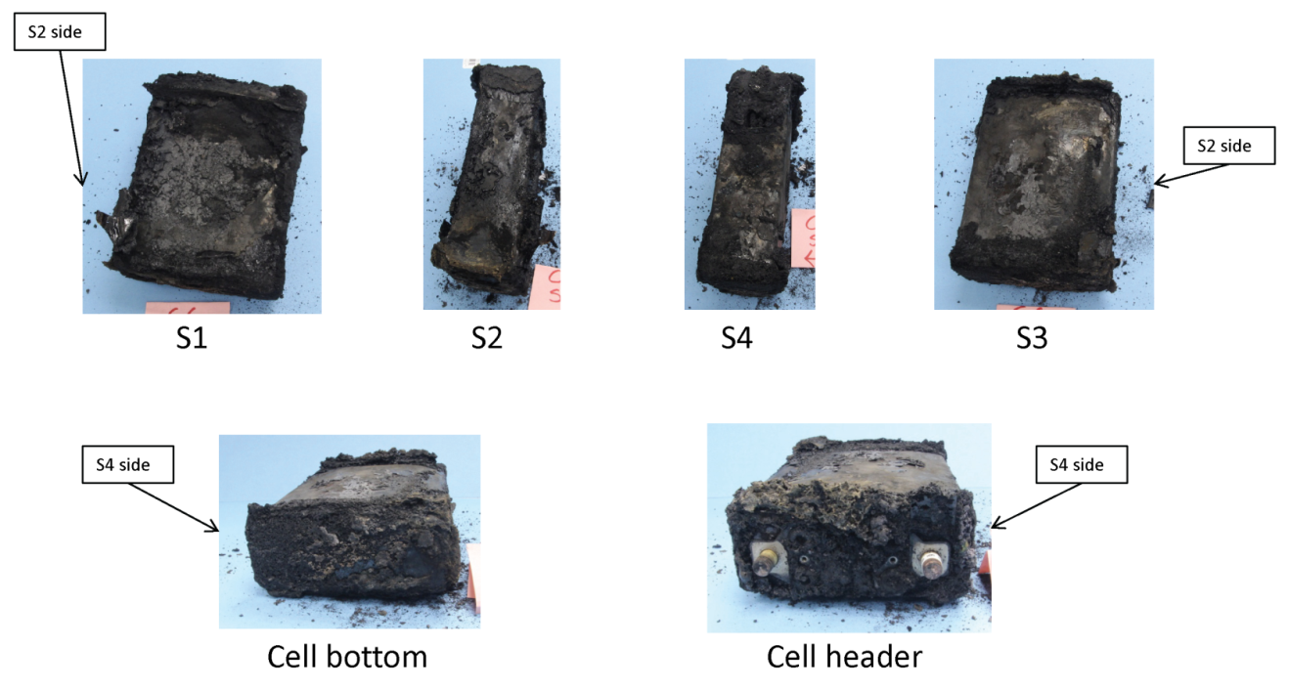
Initial Extraction of Cells

Slide 28
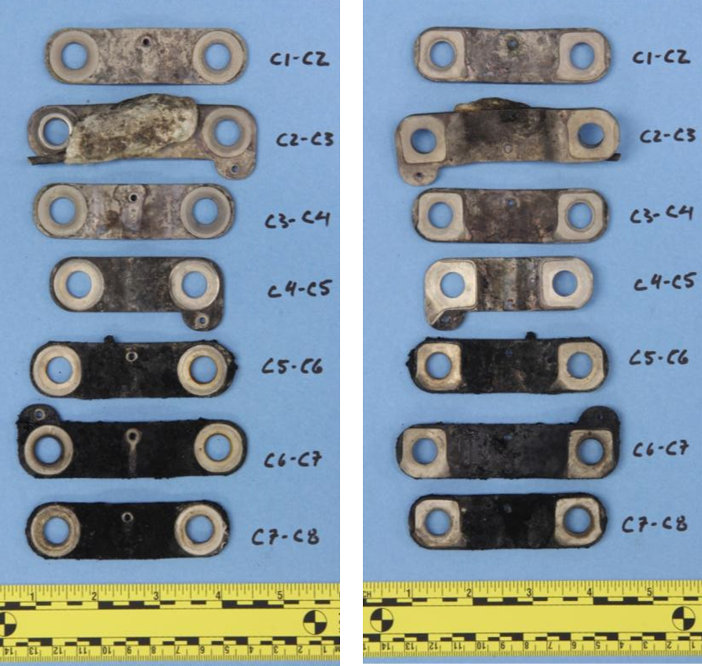
Copper Bus Bars

Slide 29
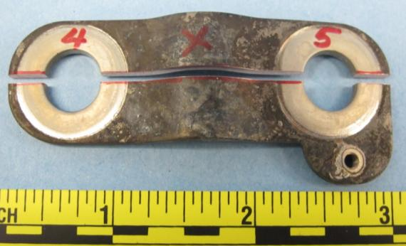
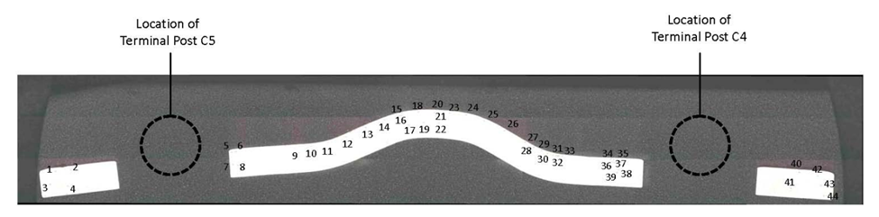
Micro-hardness Testing of Bus Bar
Sample Cut for Metallurgical Cross Section

Slide 30
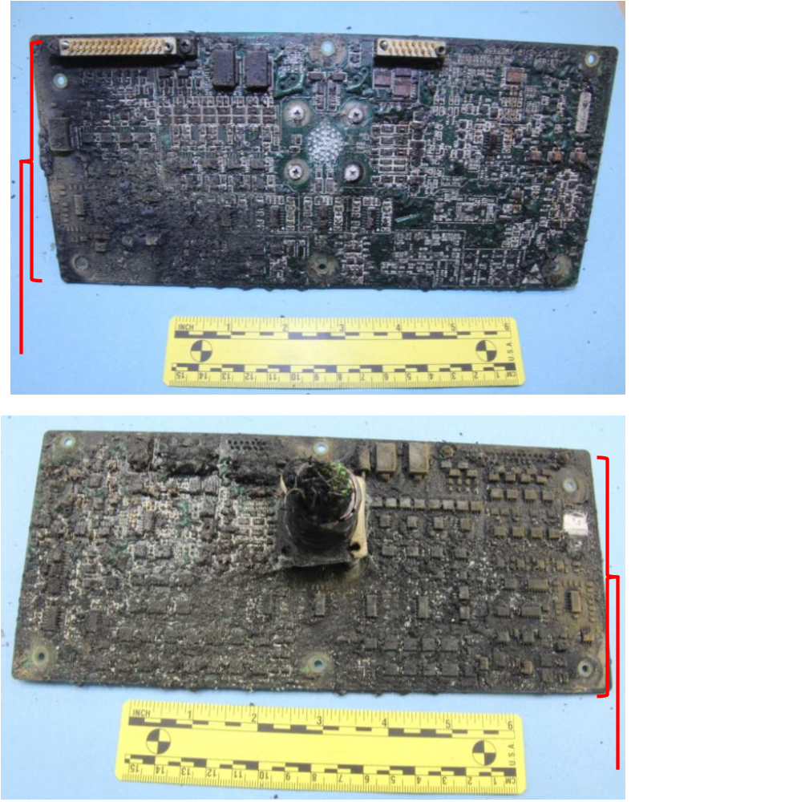
Battery Monitoring Unit Circuit Boards

Slide 31
Internal Observations (Cell Level)

Slide 32
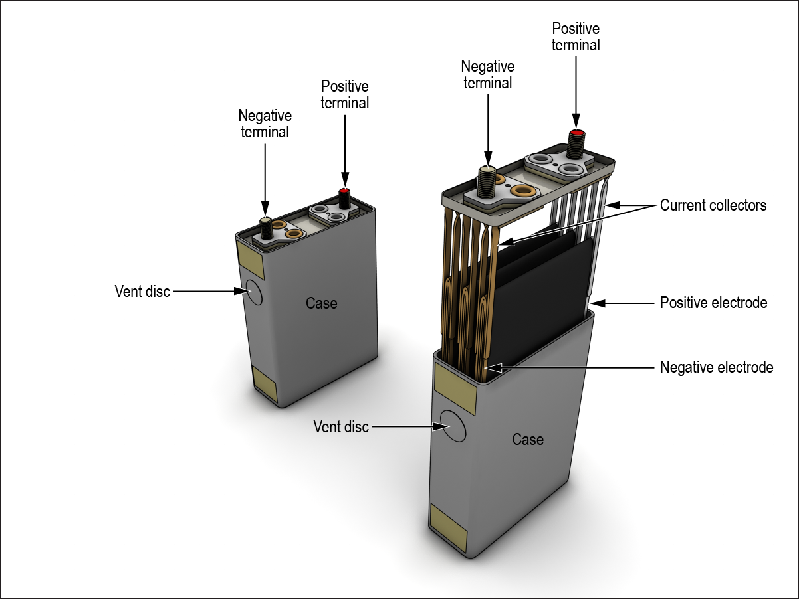
Li-Ion Cell Construction

Slide 33
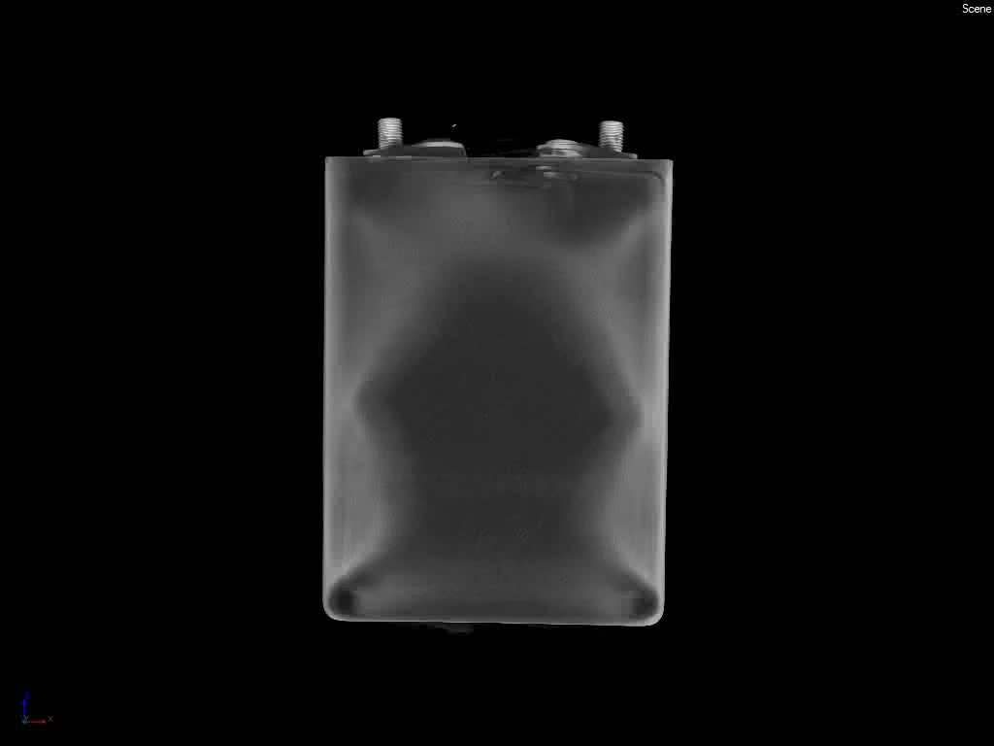
Cell #6 External View (CT scan .wmv)

Slide 34
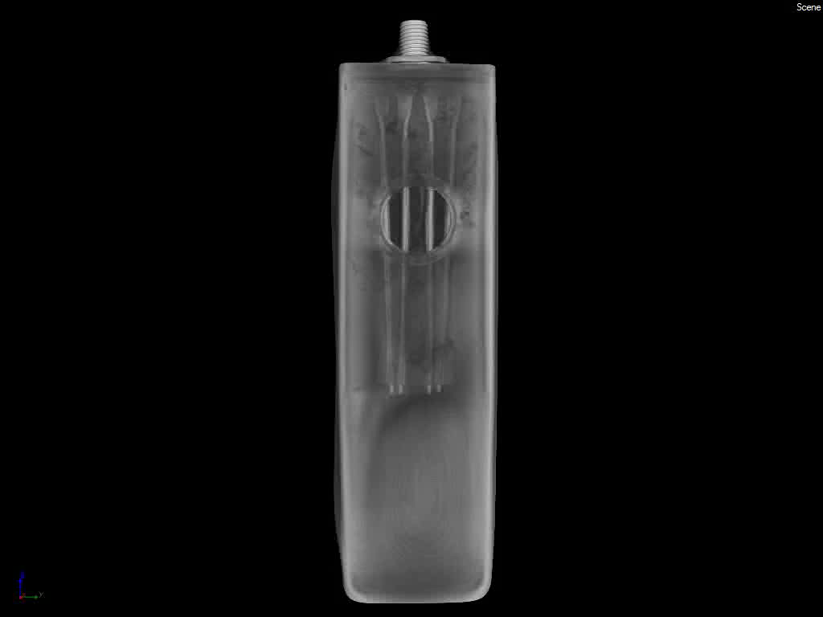
Side View of Cell 6 (CT scan .wmv)

Slide 35
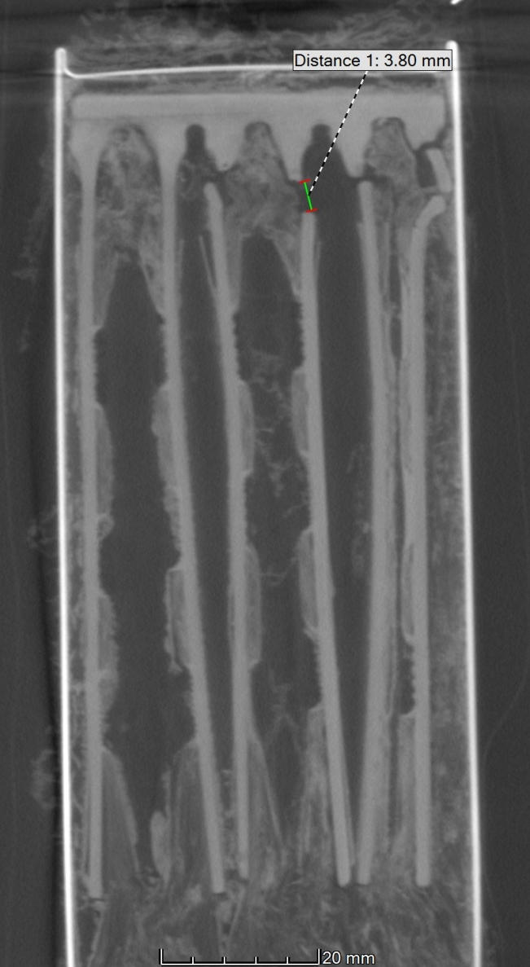
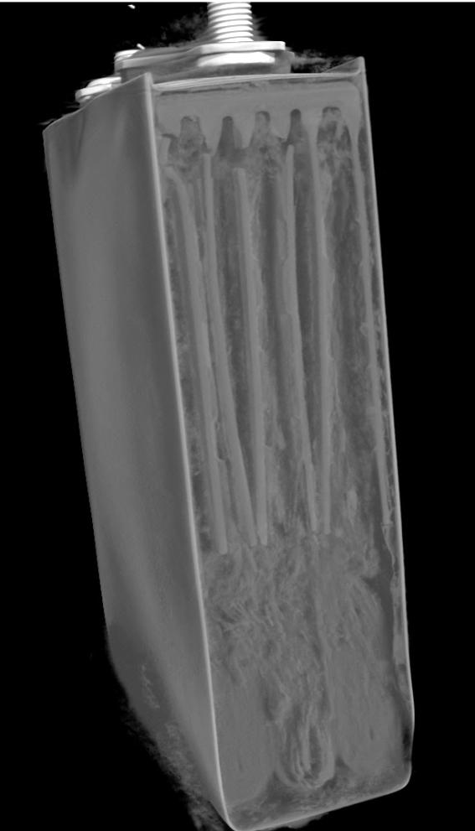
Cell #6 CT Scan Showing Current Collector Damage

Slide 36
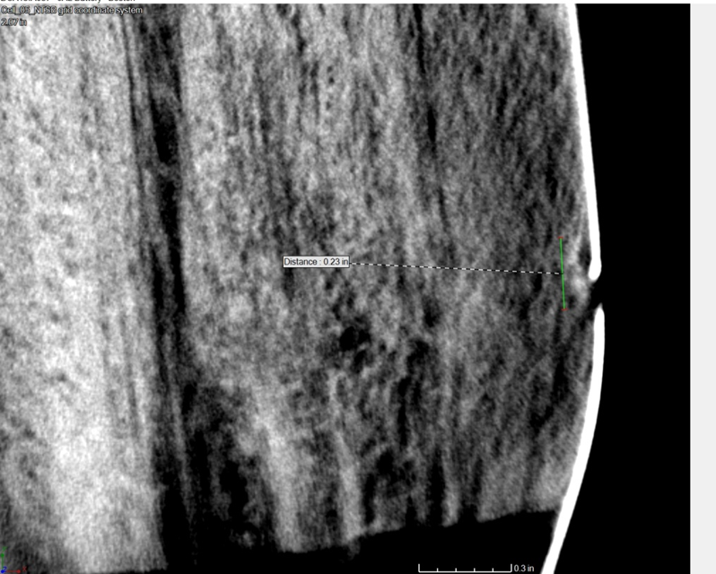
Radiographic Image Showing Breach in Cell Case

Slide 37
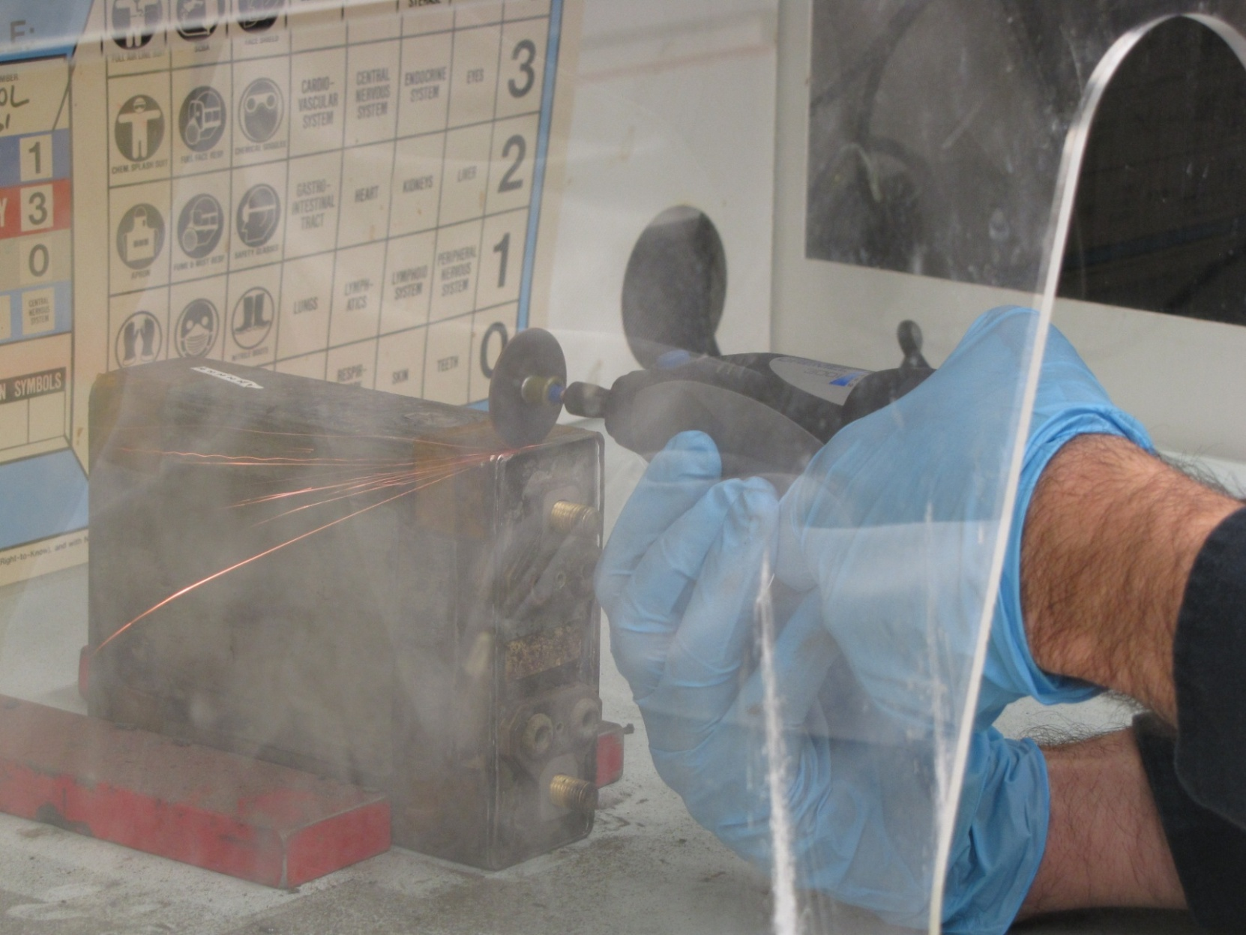
Using Dremel Tool to Open Cell Case

Slide 38
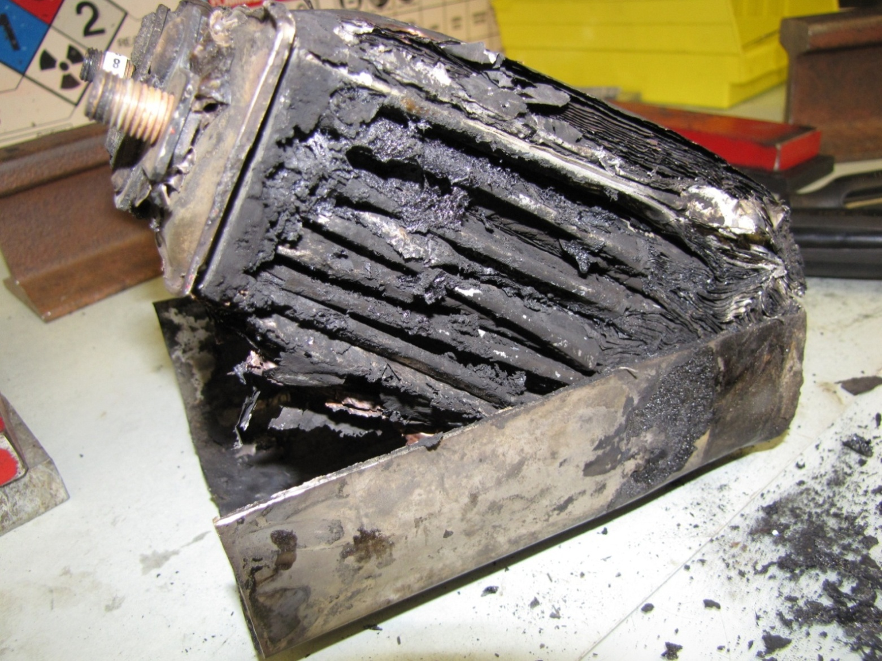
Opened Cell Showing Damaged Electrodes

Slide 39
Electrode Construction
separator
Carbon-based material
Cu
Carbon-based material
separator
Li-CoO₂-based material
Al
Li-CoO₂-based material
Not to scale

Slide 40
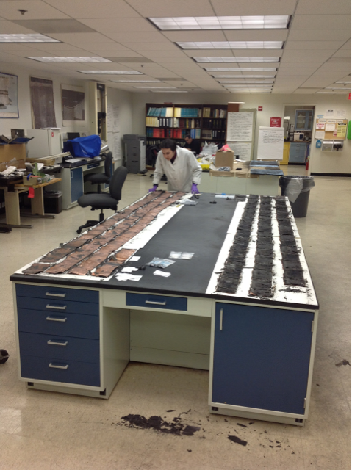
Two Sets of Electrodes Unwound in Lab

Slide 41
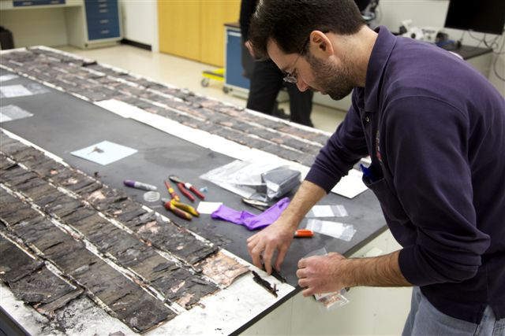
Two Sets of Electrodes

Slide 42
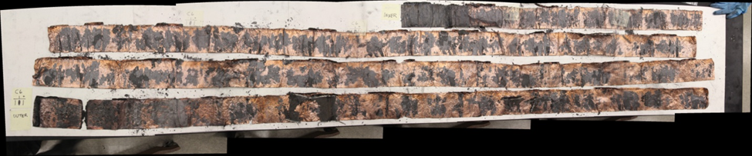
One Electrode “Jellyroll” Unwound
10 feet

Slide 43
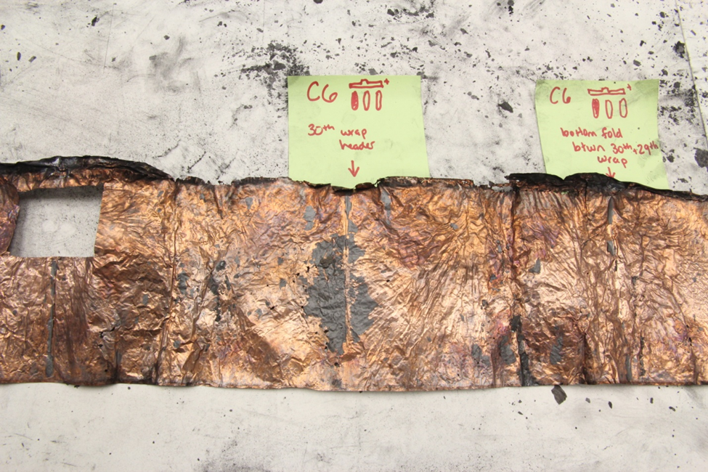
Cell 6 Electrode Damage

Slide 44
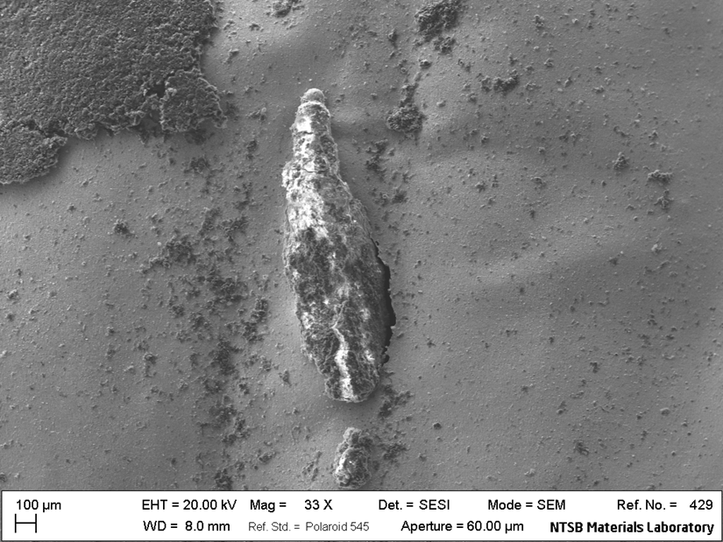
Re-solidified Aluminum on Copper Foil
(SEM Image)

Slide 45
Laboratory Testing
Battery Level
Cell Level
Electrode Level

Slide 46
Laboratory Testing – Battery Level
Determine uniformity of charging individual cells
Examine thermal distribution during charge/discharge cycles
Determine battery response to charging anomalies

Slide 47
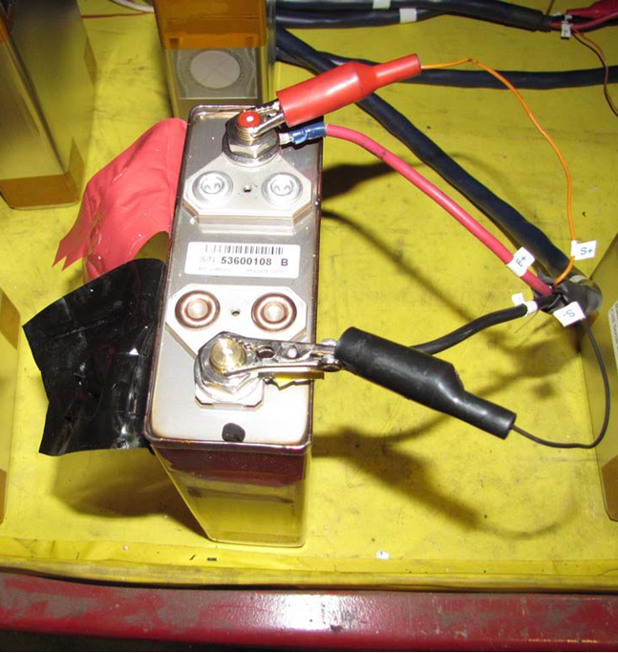
Laboratory Testing – Cell Level
Examine manufacturing uniformity (Destructive Physical Analysis– DPA)
Test for soft shorts

Slide 48
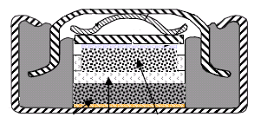


Laboratory Testing – Electrode Level
Assembly# of Coin Cell
Photograph of Coin Cell
SS can
SS wave
spring
Cu spacer
Cu substrate
Anode Electrode
Separator
Cathode Electrode
Gasket
Al substrate
Coin-cell testing
  Examine susceptibility to lithium plate out
  Examine uniformity of electrode coatings and anode/cathode ratios

Slide 49
In Summary,
Investigation of Battery Required Resources Beyond NTSB Internal Capabilities
New Technology - Multiple Sources of Expertise
Fragile and Microscopic Features– Non-Destructive Methods
    Radiography/CT scanning
    Scanning Electron Microscope (SEM)
Material Science and Chemistry Aspects
  SEM/EDS
  FTIR
  Micro-hardness Testing

