Slide 1
Evaluation of the Transport Rotorcraft Airframe Crash Testbed (TRACT) Full Scale Crash Test
FAA Seventh Triennial International Fire & Cabin Safety Research Conference
2-5 December, 2013
Martin Annett, Justin Littell PhD.
Structural Dynamics Branch
NASA Langley Research Center

Slide 2
NASA Fundamental Aeronautics- Rotary Wing Project-
  Develop and Validate Tools, Technologies and Concepts to Overcome Key Barriers for Rotary Wing Vehicles
Crashworthiness Task Focus Areas
  Crash modeling and simulation to improve predictive capabilities for structural impact.
  Assessment and analysis correlation of dynamic response of a composite prototype fuselage section subjected to vertical impulsive loads.
  Evaluation of crashworthy concepts, including active restraints, energy absorbing seats and composite subfloor.
  Development of advanced anthropomorphic test device models for aerospace crashworthiness

Slide 3
TRACT
OBJECTIVE
  Evaluate transport category rotorcraft crash response under combined horizontal and vertical loading.
  Evaluate structurally efficient energy absorbing composite airframe structure.
APPROACH
  Acquired (2) medium-lift CH-46 fuselages
  Collaborate with FAA, DOD and industry
  First test conducted with novel crashworthy features and variety of ATDs
  Introduce energy absorbing composite subfloor concept for second test.
EXPECTED SIGNIFICANCE
  Improved crashworthiness of NextGen airframe structures.
  Crash certification by analysis.

Slide 4
TRACT Collaborators
FAA Civil Aeromedical Institute- Oklahoma City, OK
  Specialized side-facing ATD
  Data acquisition system
NAVAIR Crashworthy Systems Branch, Patuxent River, MD
  ATDs
  Standing ATD experiment
  Cargo restraint experiment
  Data acquisition system
  High speed cameras
Army Aeromedical Research Lab, Fort Rucker, AL
  ATDs
  Patient litter experiment
  Data acquisition system
  High speed cameras
Cobham Inc.
  Active restraint experiment

Slide 5
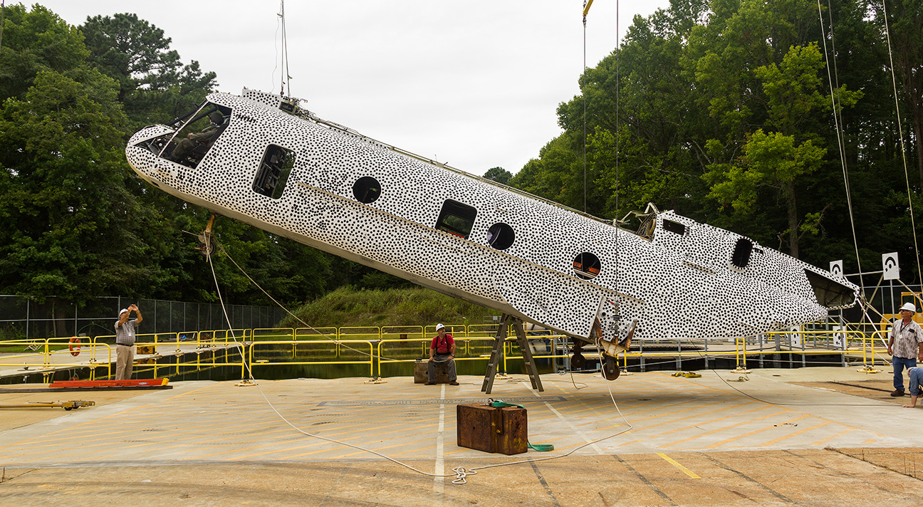
TRACT Configuration
Approximate dimensions
  42 ft long, 7 ft wide, 7 ft tall
Test article weight ~10,300 lb (bare weight ~4,000 lb).
Center of gravity (c.g.)
  Vertical c.g. 6 inches above the waterline and 3 inches above the swing beam
  Lateral c.g. < 1 inch from the center line
  Longitudinal c.g. near FS 260.0
345 channels of data (10 kHz):
  Airframe accelerations
  Swing and pullback cable loads
  ATD-specific responses
  Head, chest, and pelvic accelerations
  Neck and lumbar forces and moments
  Chest Deflection
  Leg rotation
  Restraint forces
Two ruggedized onboard data acquisition systems
  DTS (NASA, FAA, USAARL)
  Kistler/K-T (NAVAIR)
Weight and Balance

Slide 6
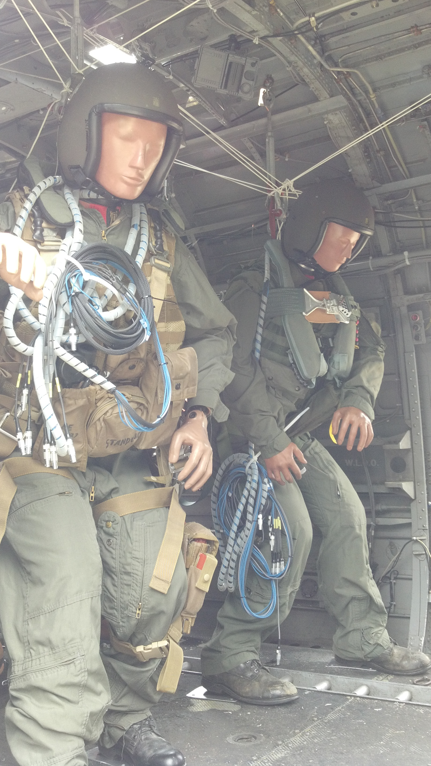
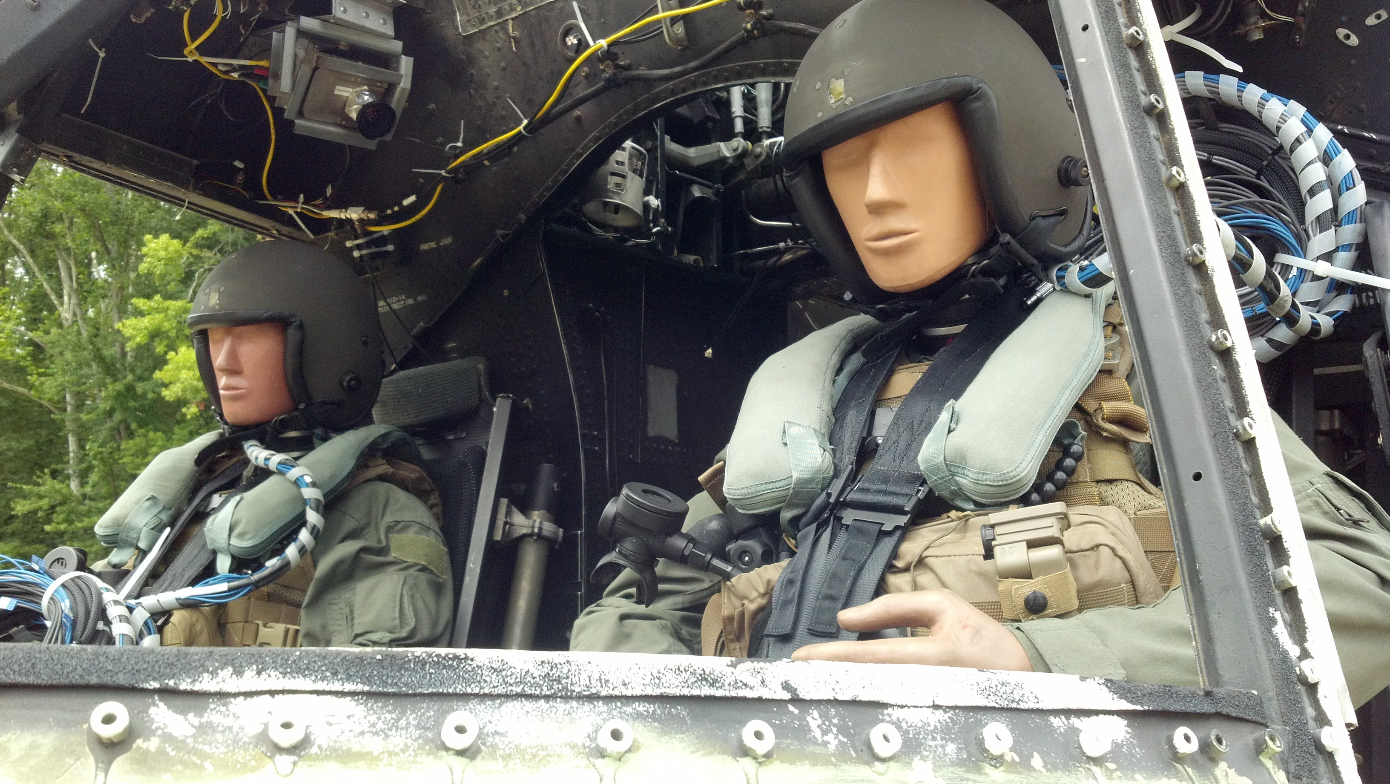
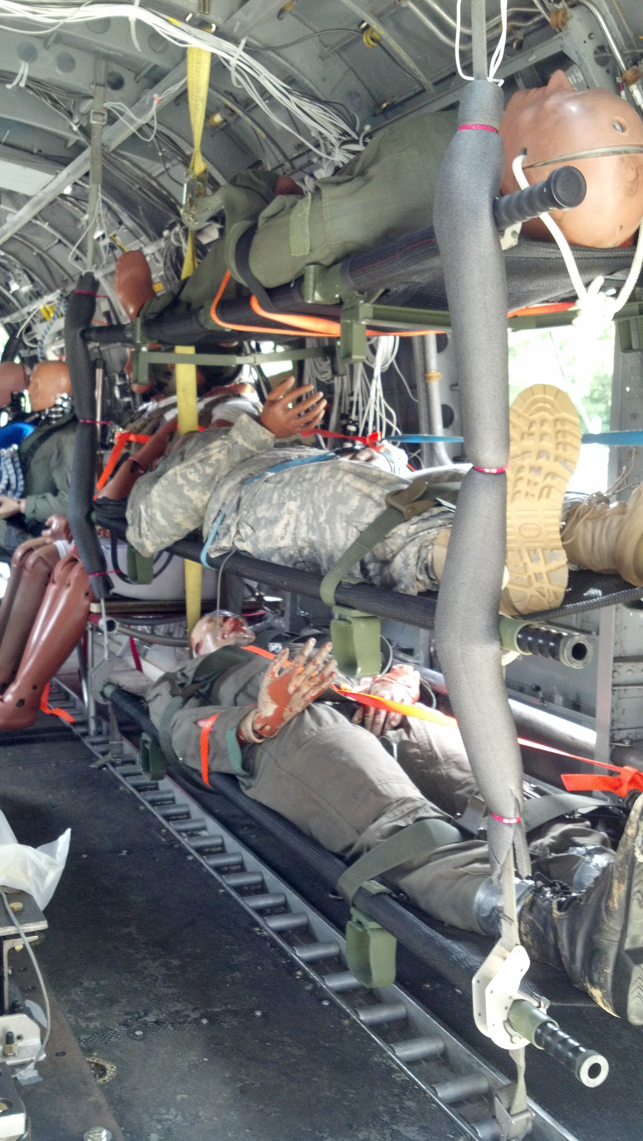
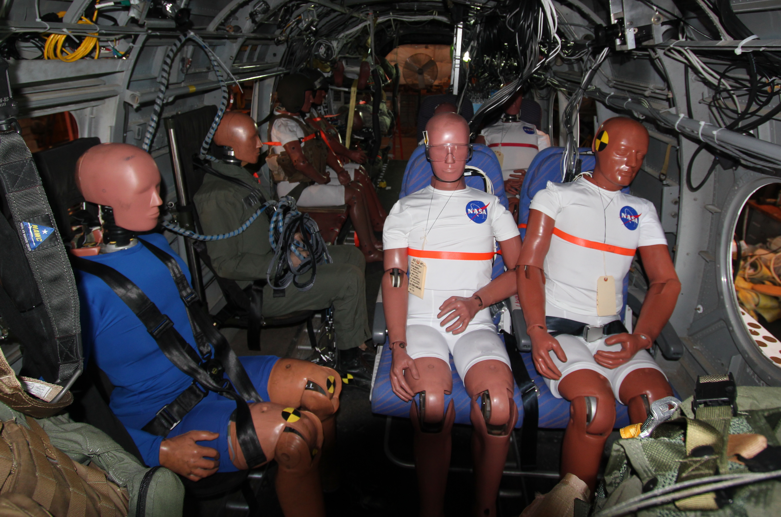
TRACT Configuration
(13) instrumented ATDs and (2) manikins
  NASA- 50th Hybrid II, 50th FAA Hybrid III, 5th Hybrid III female, 95th Hybrid III
  FAA- 50th ES-2re neck/Hybrid III
  Navy- 5th and 50th Aerospace Hybrid III
  Army, 50th Hybrid III pedestrian, GARD
  Position in energy absorbing crew seats, side facing troop energy absorbing seats, side facing benches, forward facing aircraft seats, litter, and standing
Pyro-actuated active restraint
Mobile aircrew restraint
Cargo restraint experiment
Cockpit ATDs
Litter ATDs
Standing ATDs
Side and forward facing cabin ATDs

Slide 7
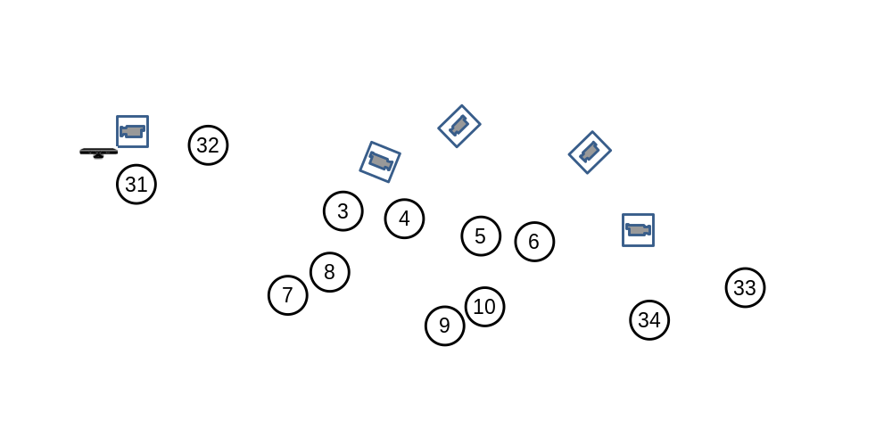
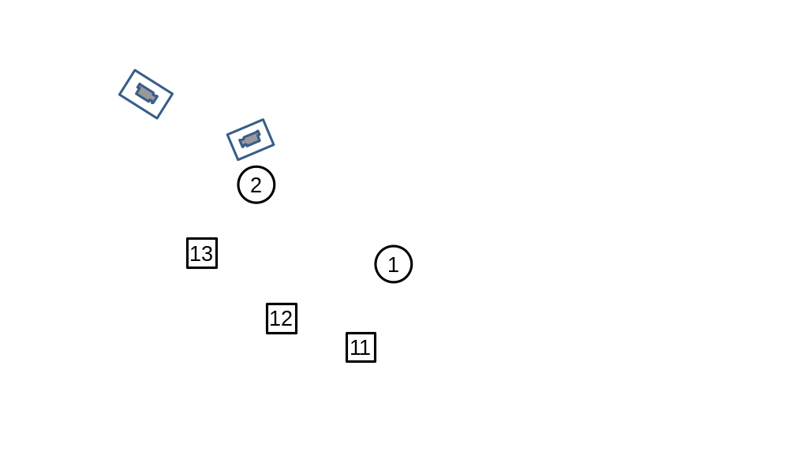
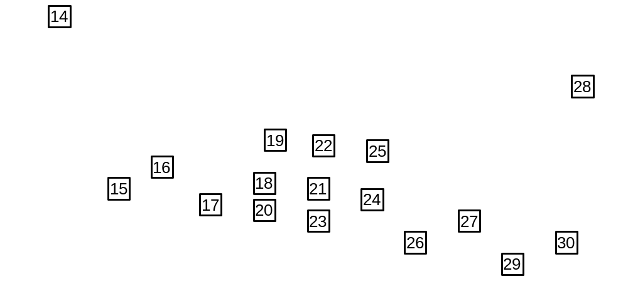
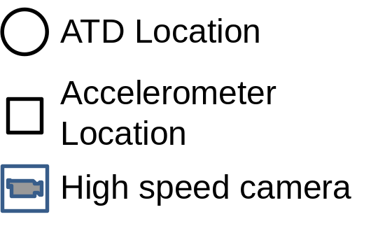
TRACT Configuration

Slide 8
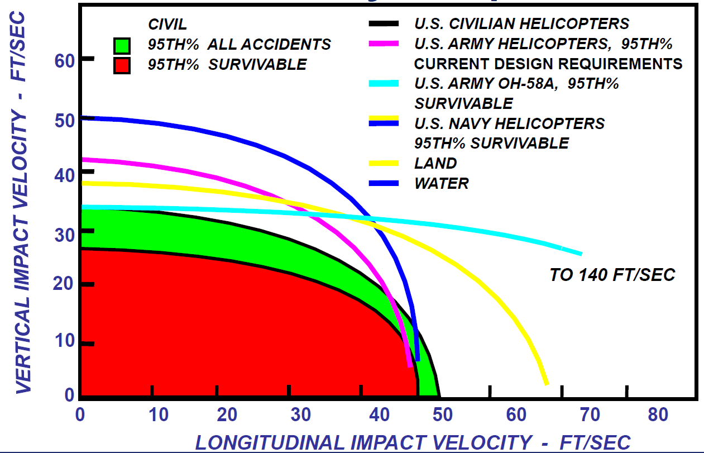
TRACT Impact Conditions
Velocity conditions
  26 ft/sec vertical
  35 ft/sec horizontal
  Considered severe but survivable
2 degree pitch-up angle
  Mitigate nose-down condition at impact
Soil impact surface
  Based on mishap data
  120 ft long x 20 ft wide x 2 ft tall
  Combination sand/clay mix
TRACT

Slide 9
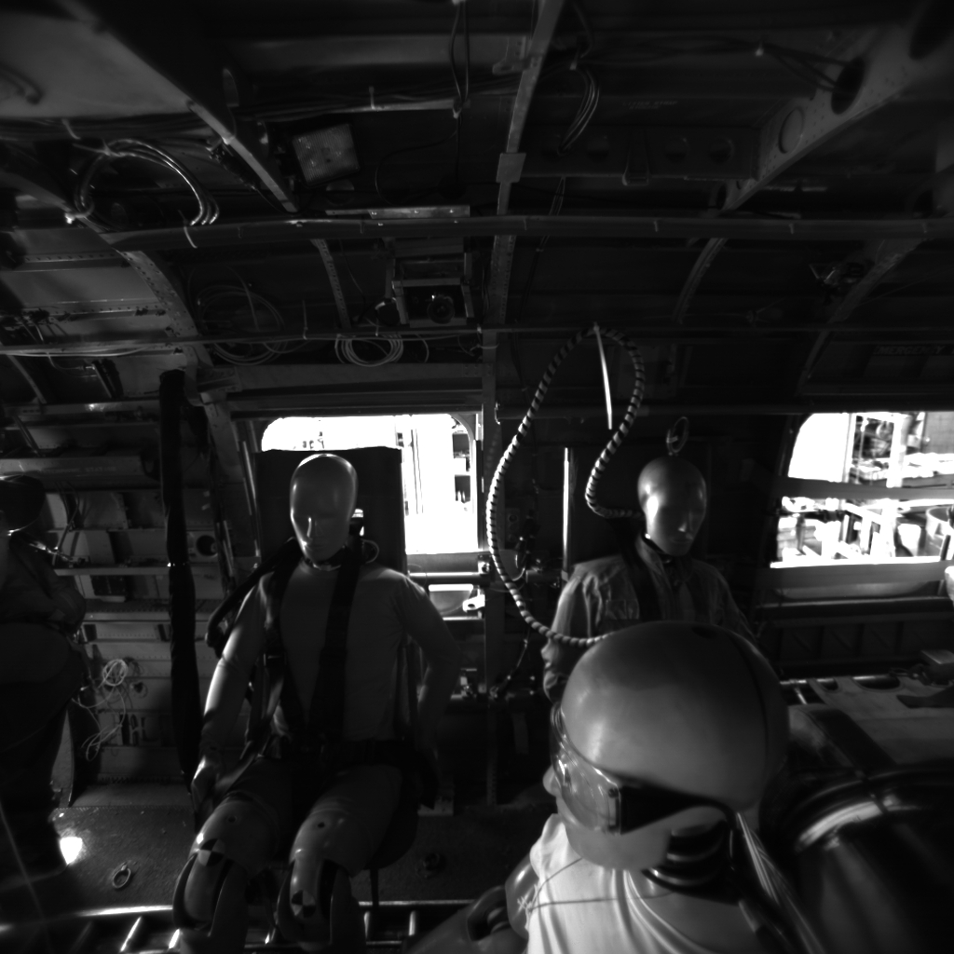
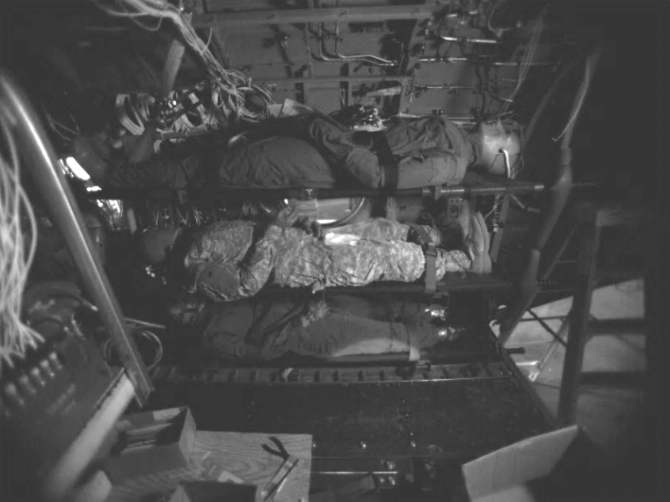
Onboard high speed cameras
Ruggedized onboard high speed cameras filming ATD’s at 500 frames per second
  4 black and white and 3 color
Tracking targets used to track occupant kinematic motion
  2D Photogrammetric techniques
Kinematics, along with ATD instrumentation will establish probabilities and locations of injury
Side facing ATDs
Co-Pilot ATD
Litter ATDs

Slide 10
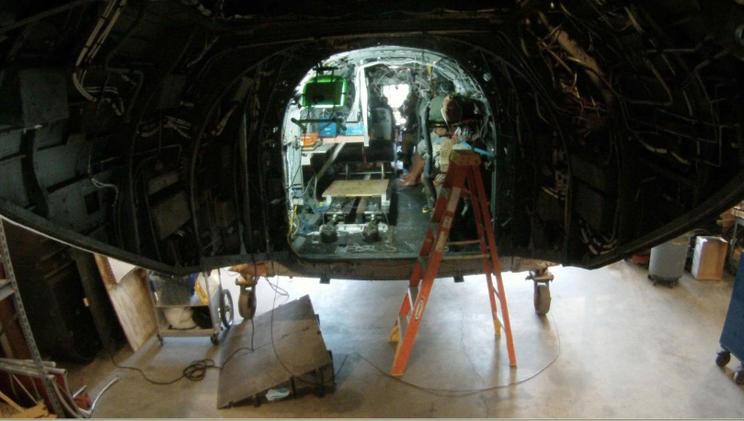
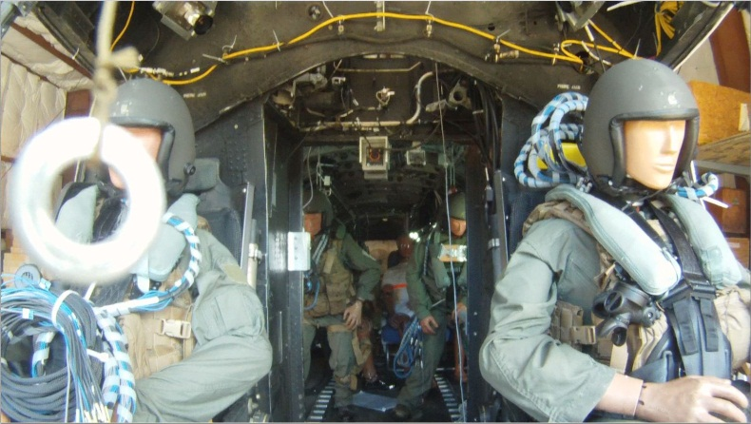
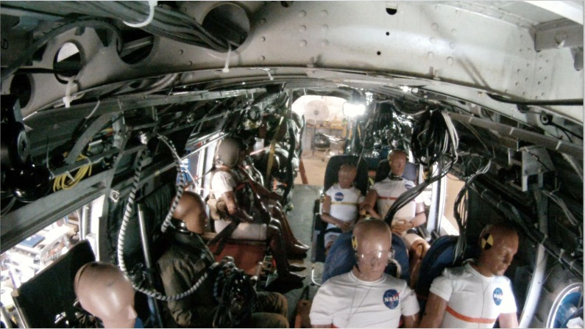
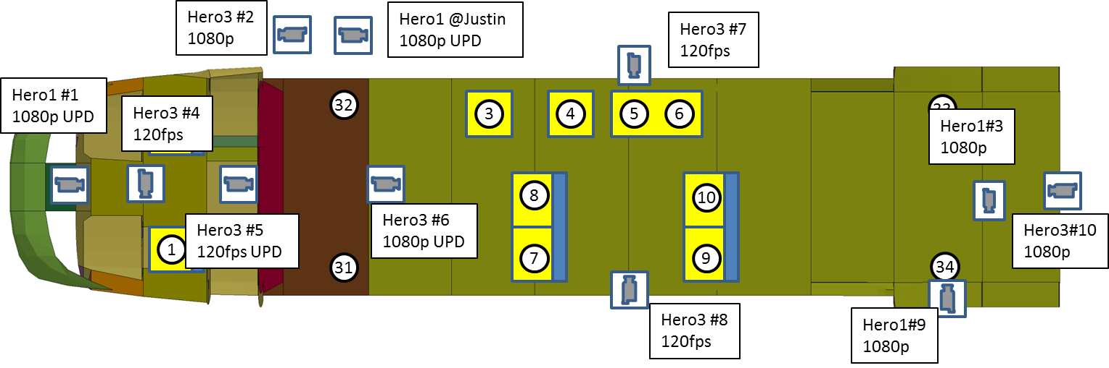
Onboard HD cameras
Tail Looking Forward
Cockpit Looking Aft
Cabin Looking Aft
11 GoPro Hero v1 or v3 cameras
  Data cams 720p @ 120 fps
  Video coverage cams 1080p @ 60fps

Slide 11
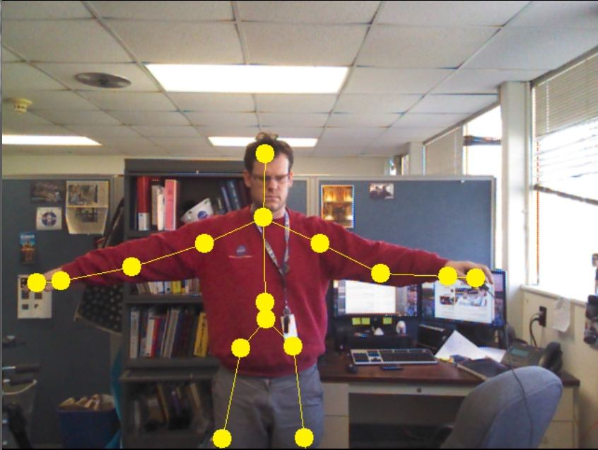
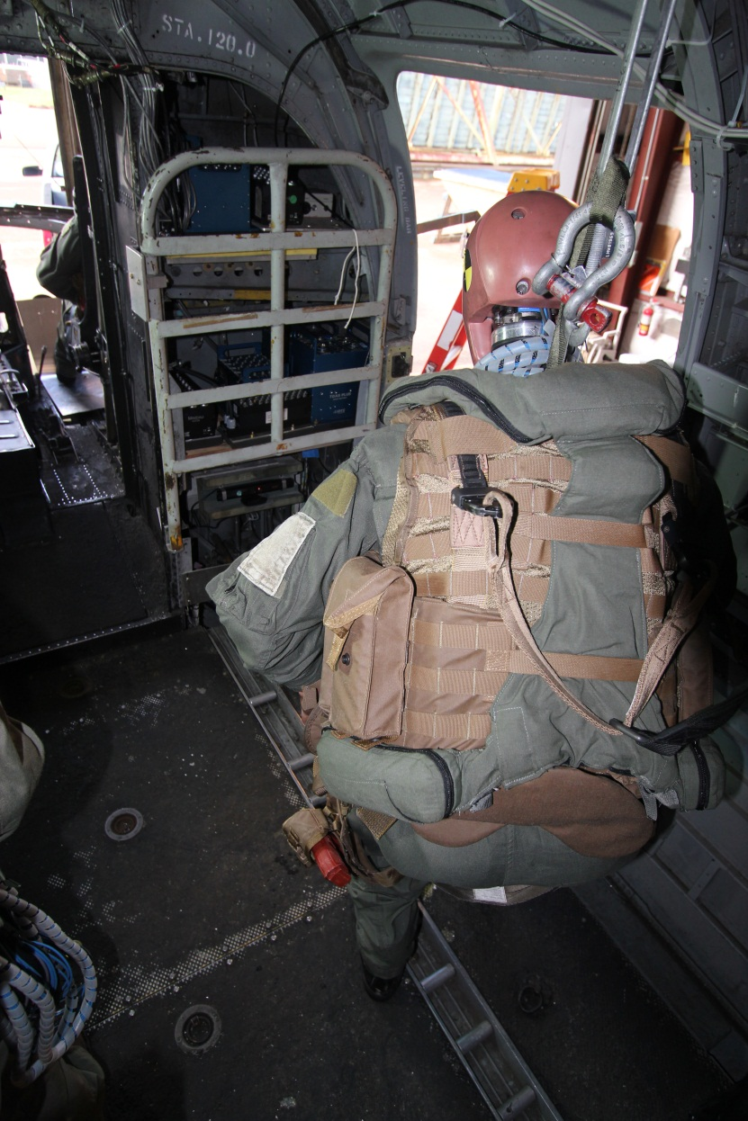
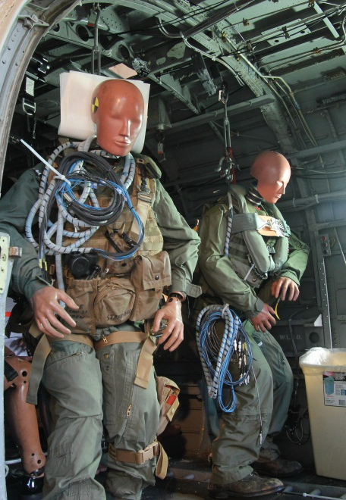
Markerless Tracking-Kinect Experiment
Early bench test
Bulkhead Shelf Camera
Early feasibility test
Track time histories of 19 different joint locations
  Potentially be used for occupant injury calculations

Slide 12
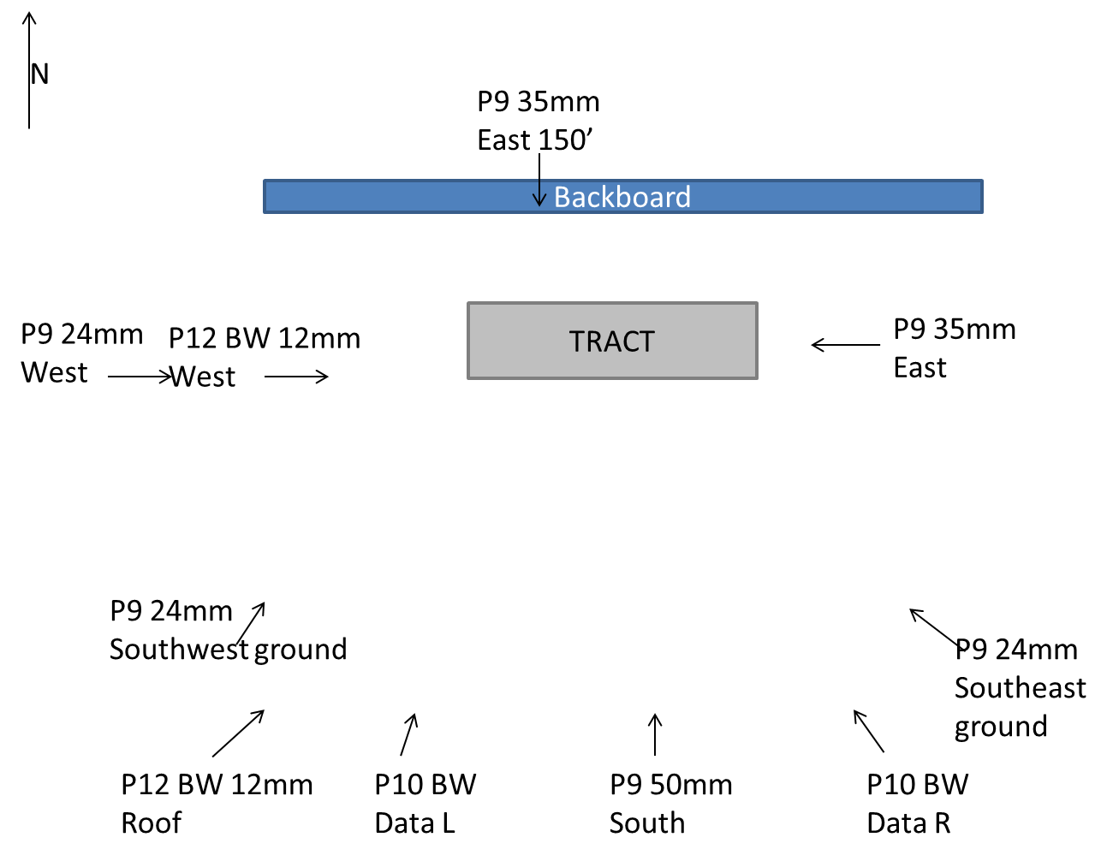
Ground High Speed Cameras
10 High speed cameras (500 – 1000 frames per second)
Full field photogrammetry skin deformation
2-D marker tracking for computation of impact conditions (speed, pitch, roll and yaw)
Impact location and general behavior of test article throughout the impact
High definition
P9 35 mm
Building 1297

Slide 13
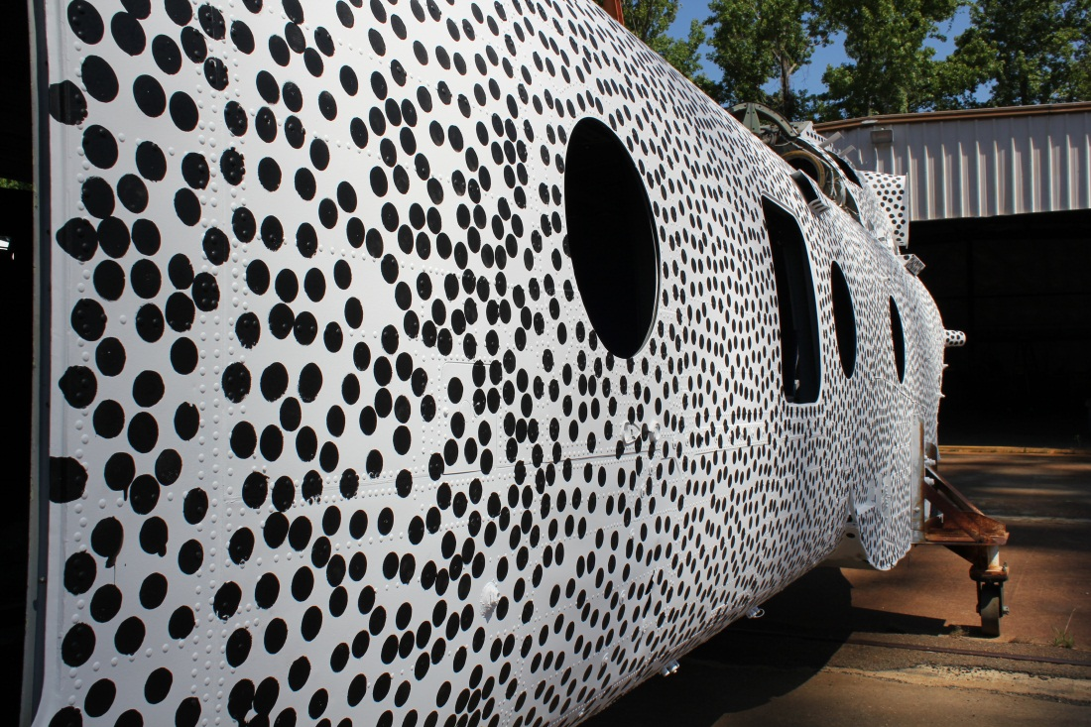
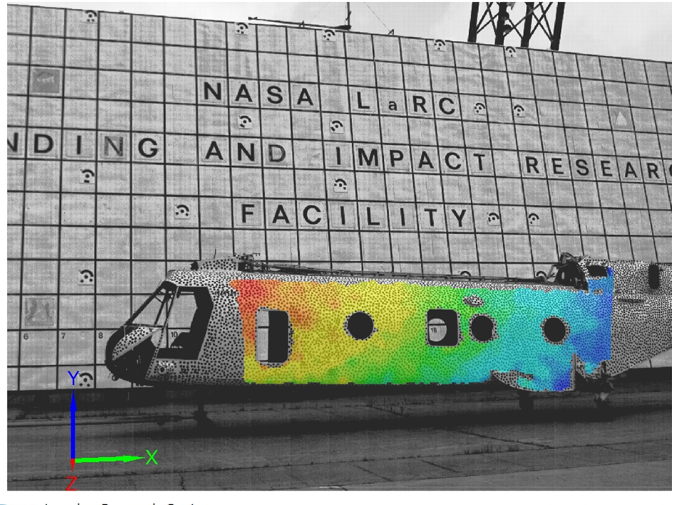
Full Field Photogrammetry Experiment
Example Full Field Overlay
1” dots applied to the south side skin
> 8000 data points along the skin
Allows for a deformation field able to be resolved over the entire south side airframe skin
  Potentially show weak areas on the airframe
Standard tracking targets for determination of impact conditions

Slide 14
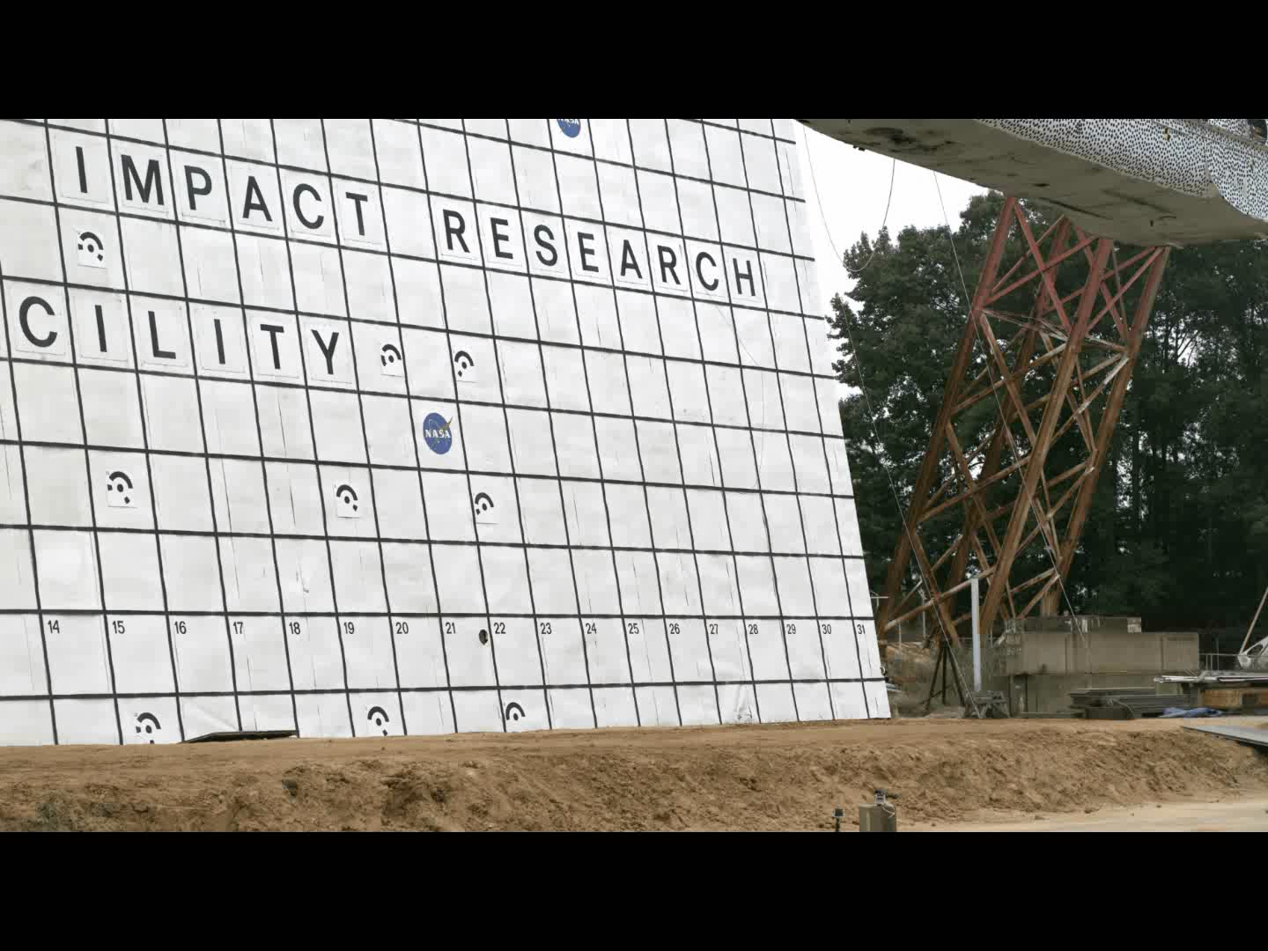
High Speed Video-External
Actual conditions: 25 ft/sec vertical, 33 ft/sec horizontal, 2.5 degree pitch-up

Slide 15
Impact Analysis
Mid cabin initial impact
t = 0
t + 30 ms
Front cabin / Cockpit initial impact
Close to cockpit max head displacement
t + 50 ms
t + 100 ms

Slide 16
Impact Analysis Continued
~Max rear rebound
Rebound has flattened out
t + 200 ms
t + 450 ms
Rear second impact
Airframe at rest
t + 550 ms
t + 900 ms

Slide 17
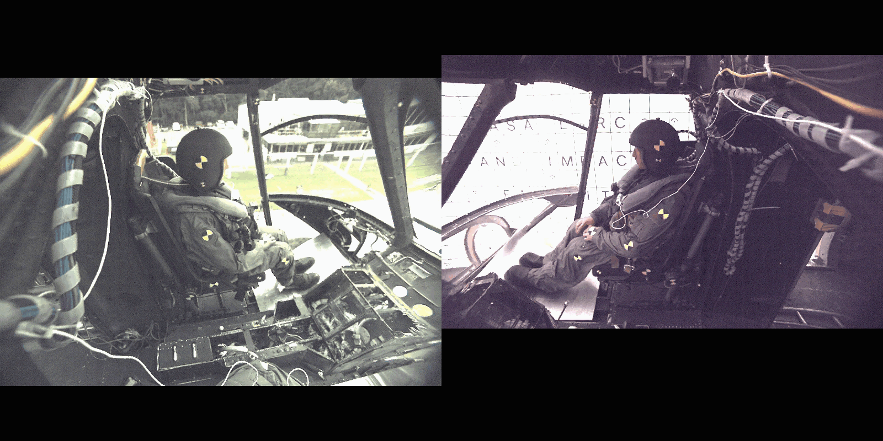
High Speed Video- Cockpit

Slide 18
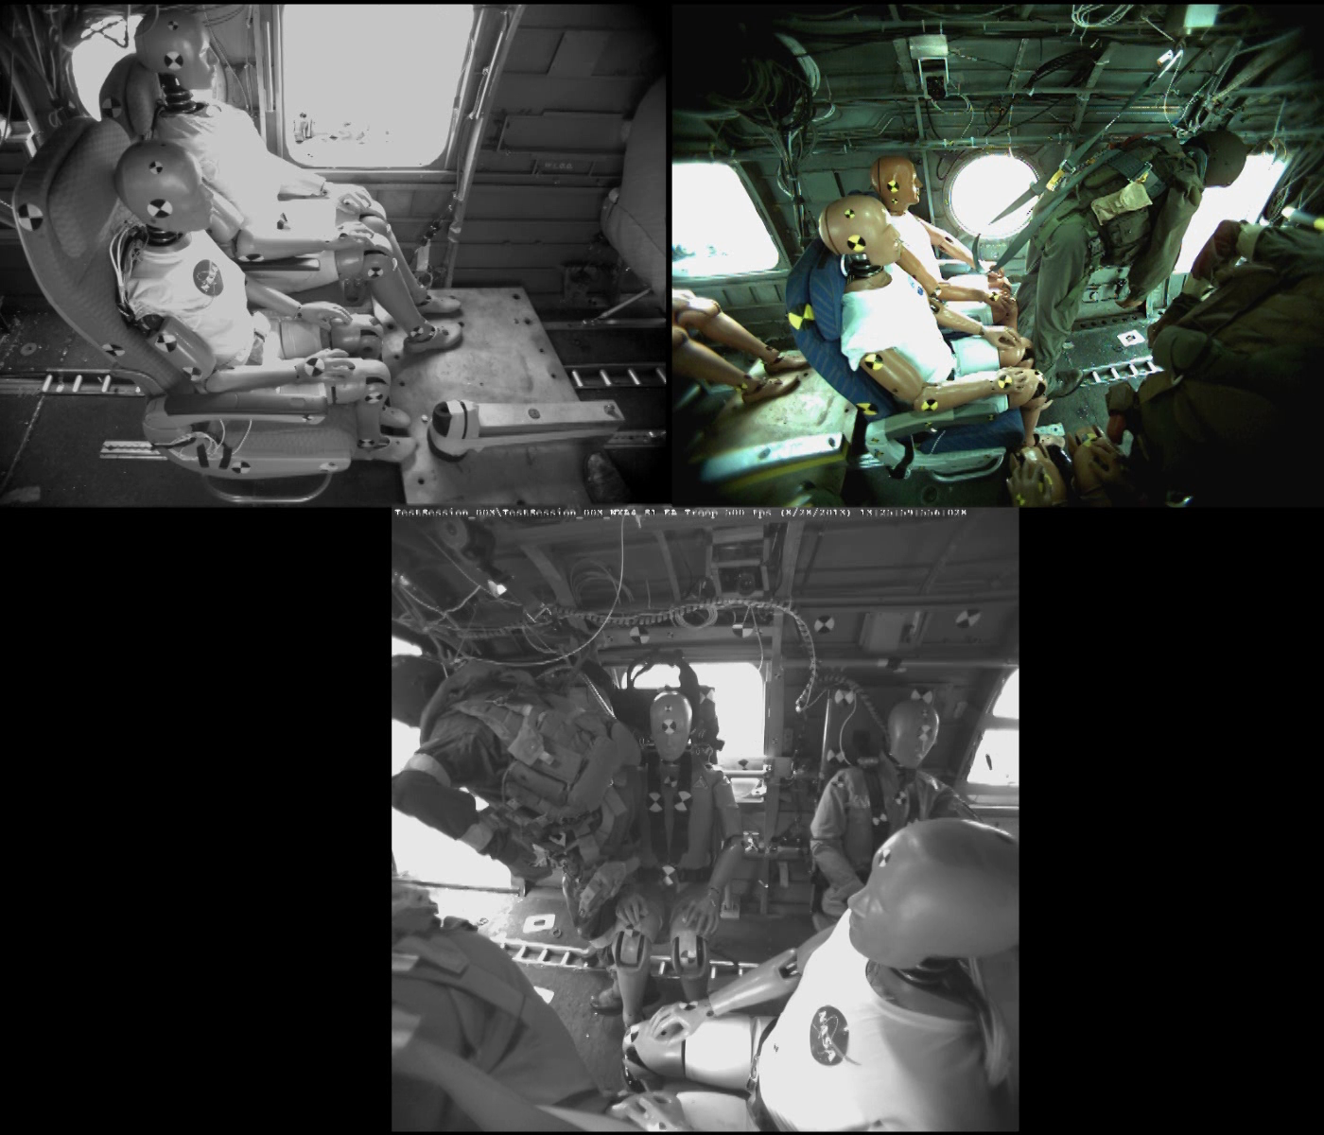
High Speed Video-Cabin

Slide 19
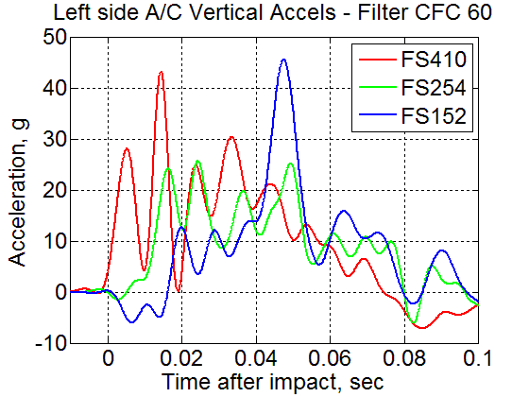
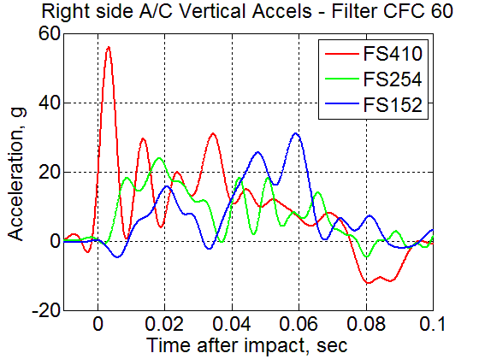
Vertical Loads – Cabin only
FS410
FS254
FS152

Slide 20
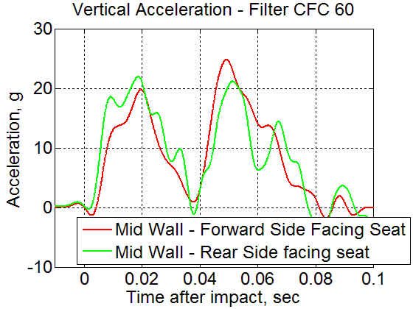
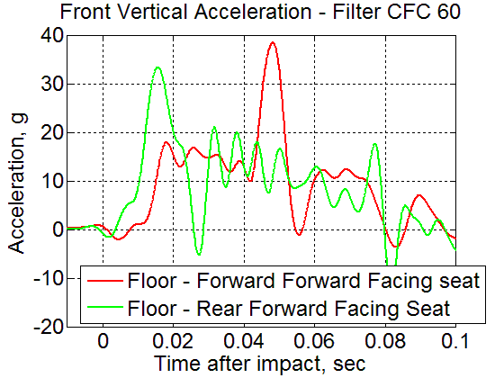

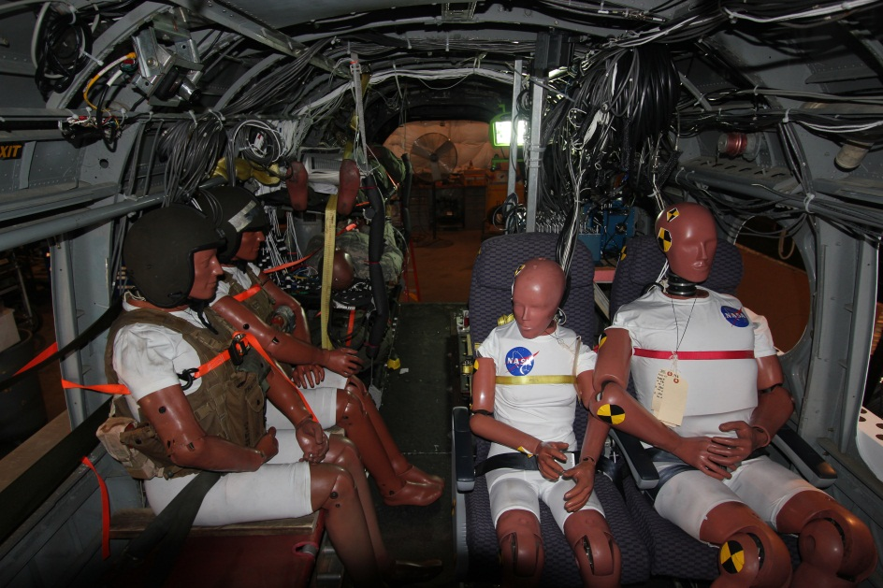
Cabin Floor Vertical Loads at Seats
Front
Front

Slide 21
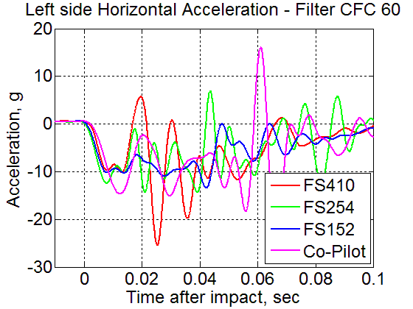
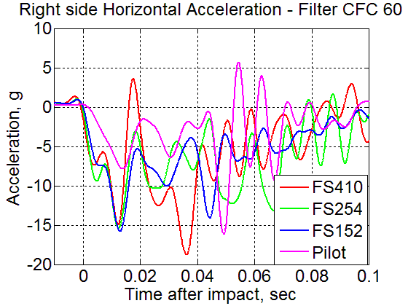
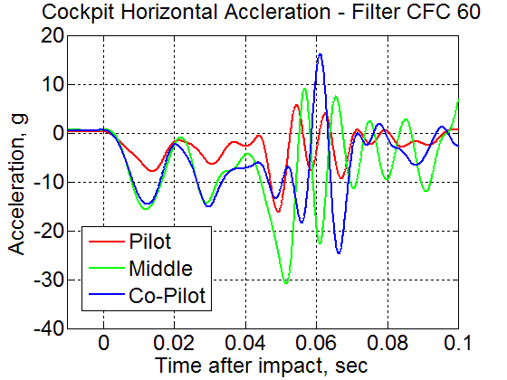
Horizontal acceleration
FS410
FS254
Pilot
FS152
Co-Pilot

Slide 22
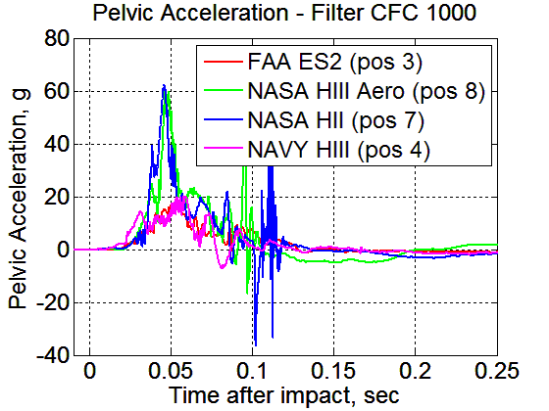
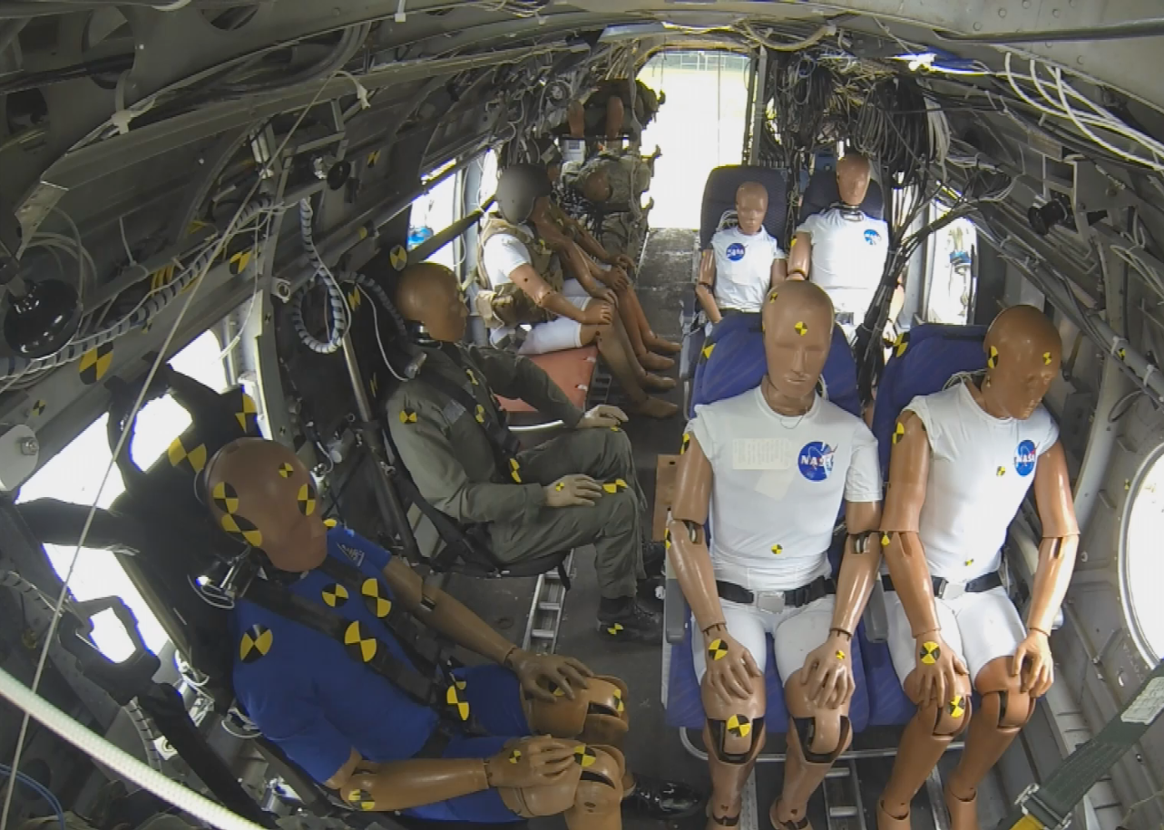
ATD Lumbar Load and Vertical Pelvic Acceleration
~1500lb.
2495 lb.
374 lb.
617 lb.
988 lb.
2,873 lb.
2,556 lb.
1,025 lb.

Slide 23
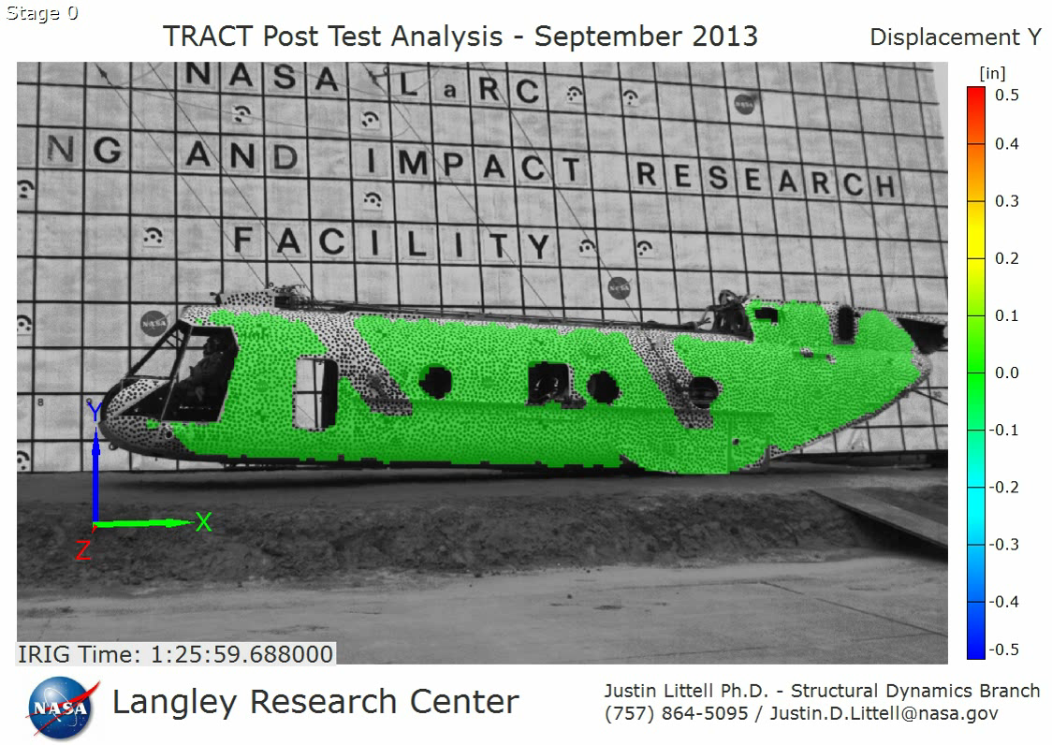
Vertical Displacement

Slide 24
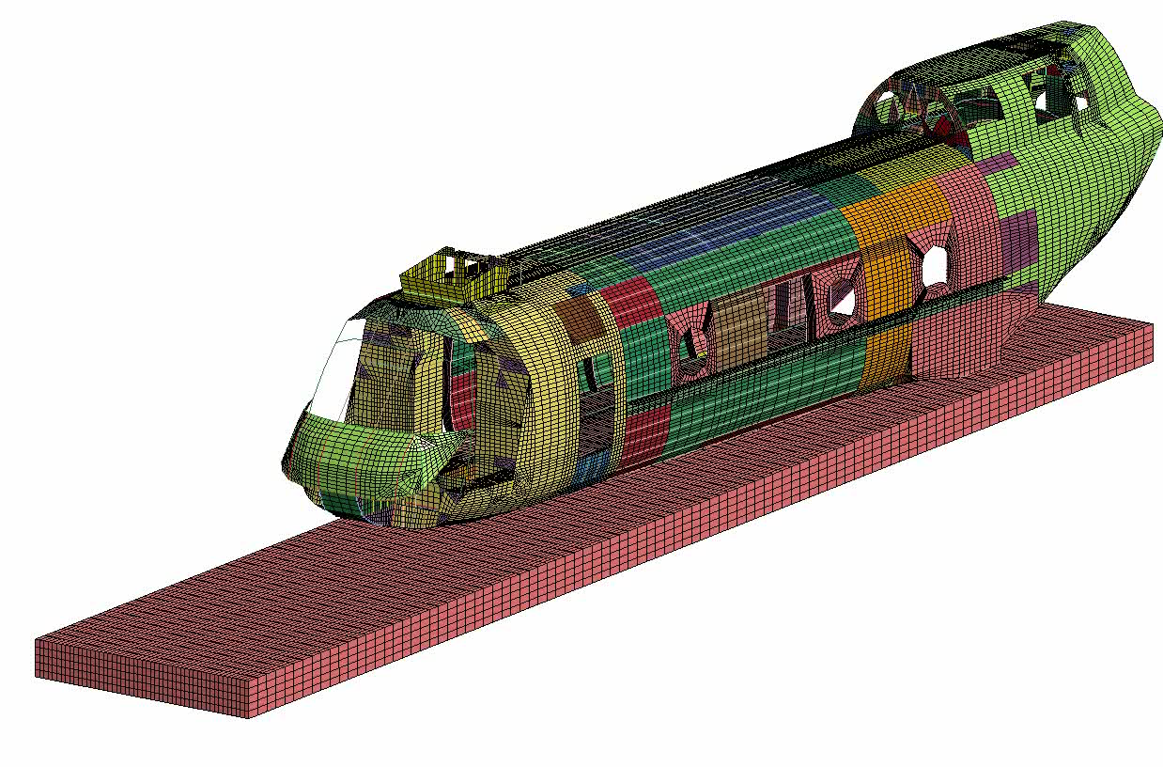
Post-test Analysis Correlation
Observations
High percentage of secondary structure modeled with bar elements with equivalent cross sectional properties
Challenges in calibrating lumped mass FEM when gross ATD motion not represented
Soil modeling parameters critical

Slide 25
Summary
Highly successful collaboration across FAA, DOD and industry
Comprehensive data acquisition and photogrammetry effort
Loads from ATDs in energy absorbing seats within injury limits
Severe injury predicted for ATDs in forward-facing passenger seats.
Full-scale tests provide valuable information in determining coupled airframe/seat/restraint/EA behavior
Ongoing/Proposed Work
  Continued data reduction and test-analysis correlation
  TRACT 2 preparation (late summer 2014)
    Interim swing test
      TRACT 1 cabin section
      Transparent floor for high speed video capture
      Develop 4-5 concepts, sandwich, truncated cone, sine wave, shear web, hybrid materials?
    Select 2-3 concepts for full-scale testing
    Incorporate ACS/DLR concept (corrugated shear web)

